Slide 1
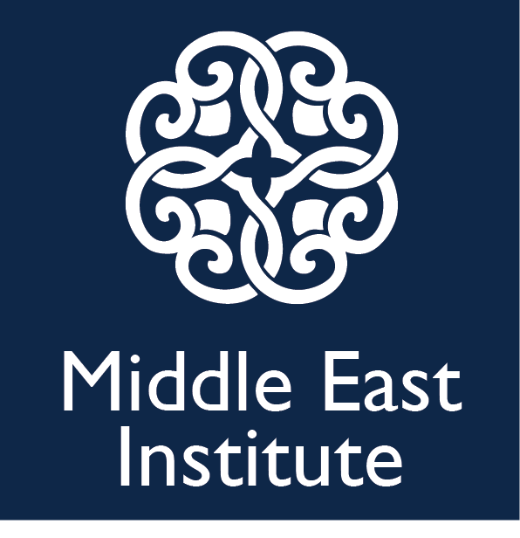
Alex vatanka Senior fellow
Iran’s Political Economy:
Key Stakeholders and Prospects for Change
Prepared for: Aramco

Slide 2
China: way forward for Iran?
40 years ago, China decided to join the world capitalist system – it worked; and arguably saved Chinese communist rule
Many in Tehran looked to China to learn, but some 30 years of talk and Iran has barely moved forward
Big difference: Chinese leaders were in agreement

Slide 3

Iran’s fragmented power setup
Rouhani (Re-elected) (57% of the vote on change)
Supreme Leader (Unelected) (Needs to balance)
Rev. Guards (Unelected) (Most opposed to change)
With Khamenei soon at 79; Rouhani has been hoping to meet rivals halfway as part of a compromise. Has not been easy.
Recent protests highlights a key question: Can Iran be a “revolutionary” & “normal” state at the same time?
The Presidency -Technocrats
Islamic Revolution Guards Corps
The Office of the Supreme Leader

Slide 4
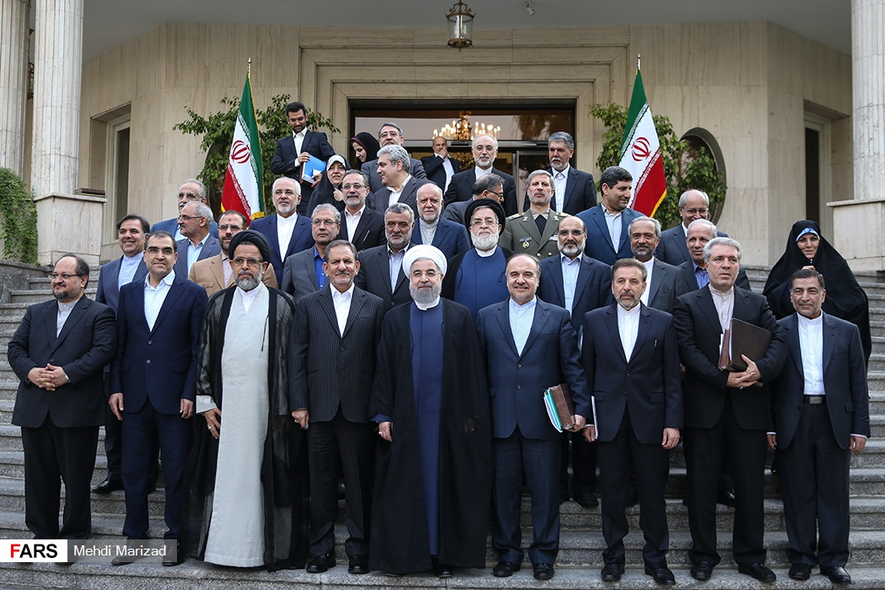
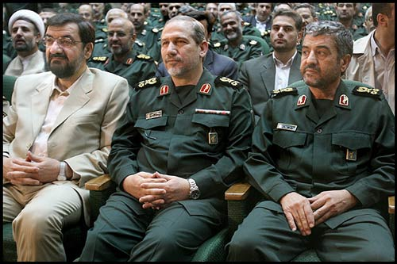
Technocrats vs. Rev. Guards
Isolation is good for IRGC business
Lessons from years of isolation

Slide 5
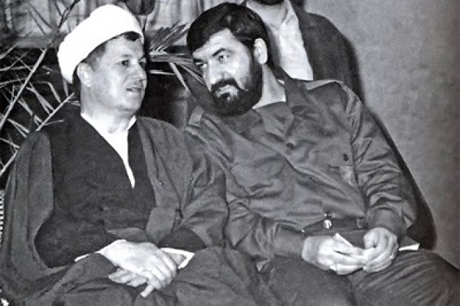
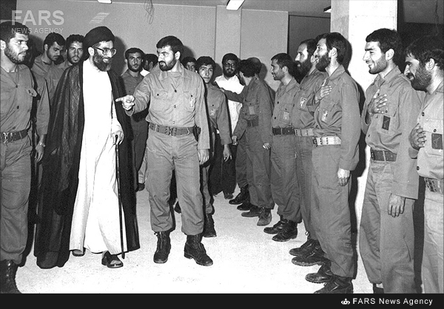
Not new: A 30+ year rivalry
Rouhani’s mentor, Rafsanjani, tried & failed to integrate/defuse IRGC as early as 1988 (“Neo-liberals”)
Instead, he sought to co-opt them with economic contracts
1989: a 49-year mid-ranking cleric in need of a support base turned to IRGC (27 yrs of solid co-existence)

Slide 6
Battle for Iran’s massive energy riches
Rev. Guards have vast economic interests (20-30% of eco.)
Engagement in profitable fields, such as the energy sector, and protective of its interests in the Rouhani era
In 2013 & 2018: Rouhani (and Khamenei) warned the Guards to lessen role in economy (mute response from Rev. Guards)
Khamenei sees Rev. Guards as his political insurance. Will keep it close to him. But Guards’ economic opportunism, incompetence and corruption feeding mass anger in society
$200bn in FDI in energy sector but is falling way short due to int. investor fears about the US but also opaque Iran system
Aimed for $50bn in FDI a yr ($9.7bn since 2015; 40% secured)
Rev. Guards and its affiliates have worked very closely with the Russians & Chinese

Slide 7
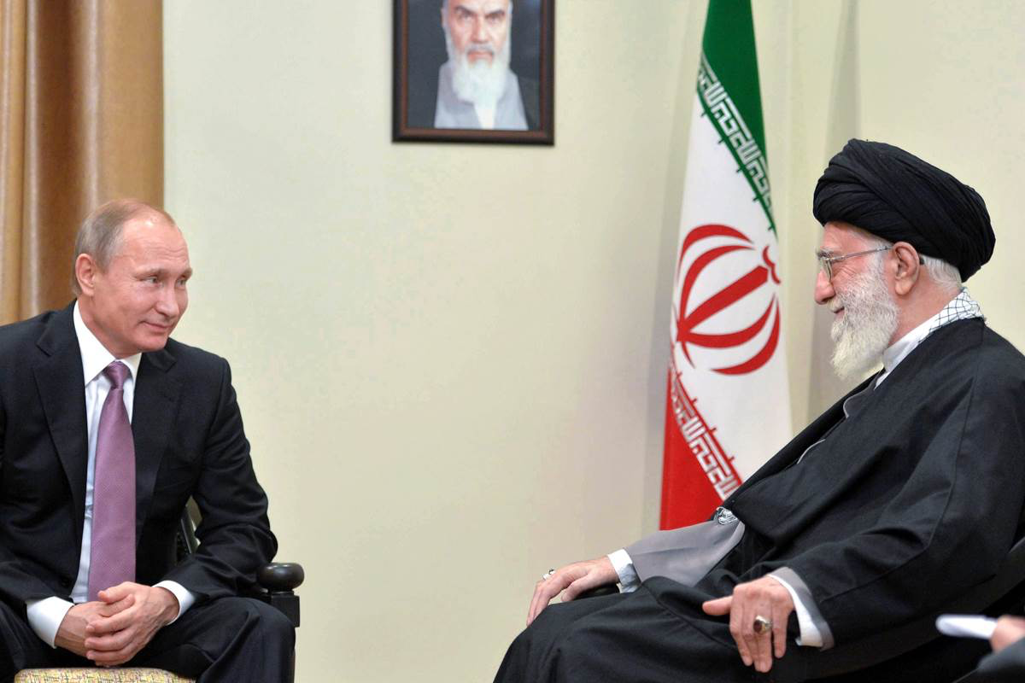
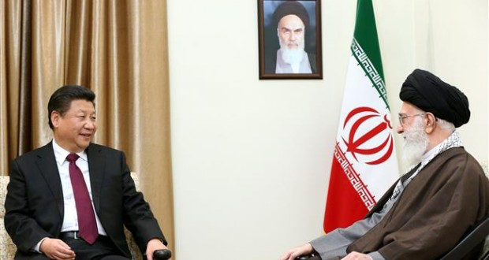
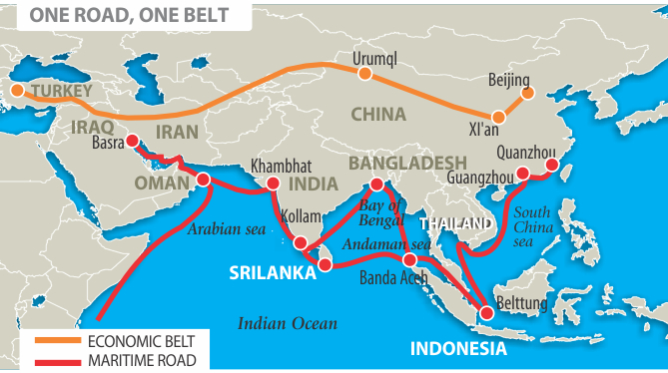
Russia and China come to Iran’s rescue?
Russia:
From arms sales, nuke plants to all sorts of ideas on investment/trade
Trade at $600bn in 10 year!

Slide 8
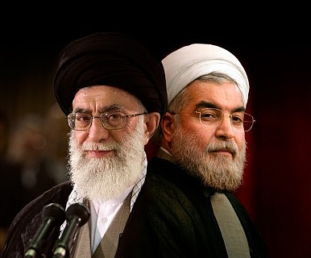
Summary: Generational and Ideological Crossroads
Key political networks engage in tough competition, often with distinct (factional) visions, but a Khamenei-led consensus remains (still) important
Rouhani is not Mr. Gorbachev. He might tweak but reluctant to confront rivals head on on foreign policy (Syria, etc.). Rouhani’s nuke-deal hopes are still economic-centered (less interested in bold political reform – Sees an improved economy as his legacy & platform to secure supreme leadership)
Doubtful Iran can have it both ways in the long-term (“revolutionary” and “normal”). The US can shape decisions via a carrot and stick strategy
In such a context, what sort of pressure is likely to work on Iran? European engagement or American containment, or combination?

Slide 9
Thanks for listening
Alex Vatanka – avatanka@mei.edu

