Slide 1


U.S. Uncoventionals Development
SAMDS, Washington D.C.
April 11, 2018
Opportunities and Challenges: Markets, Finance, Infrastructure, Community and Quality Issues
Frank A. Verrastro
Senior Vice President and Trustee Fellow
Energy, National Security & Foreign Policy

Slide 2
Rise in US Production – A Story of 3 Streams
Source: RBN Energy LLC
Uncoventionals 101– U.S. Tight Oil and Shale Gas

Slide 3
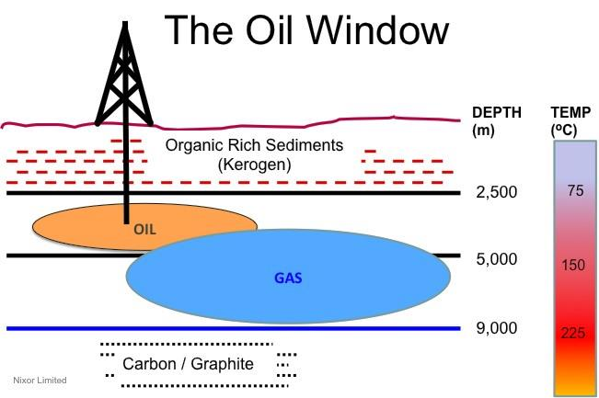
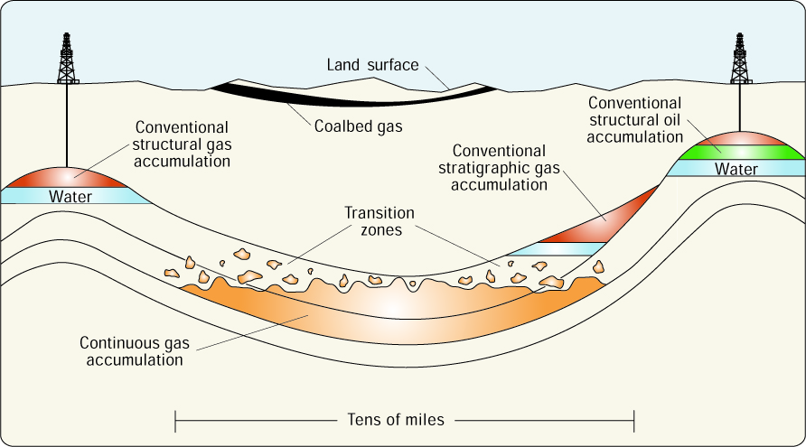
Driven by Price, Technology and Resource Accessibility
Source: Nixor Ltd. and USGS
Uncoventionals 101– U.S. Tight Oil and Shale Gas

Slide 4
Experimentation Spurred by $12/mcf Gas an $100/b Oil
Data source: Reuters
Uncoventionals 101– U.S. Tight Oil and Shale Gas

Slide 5
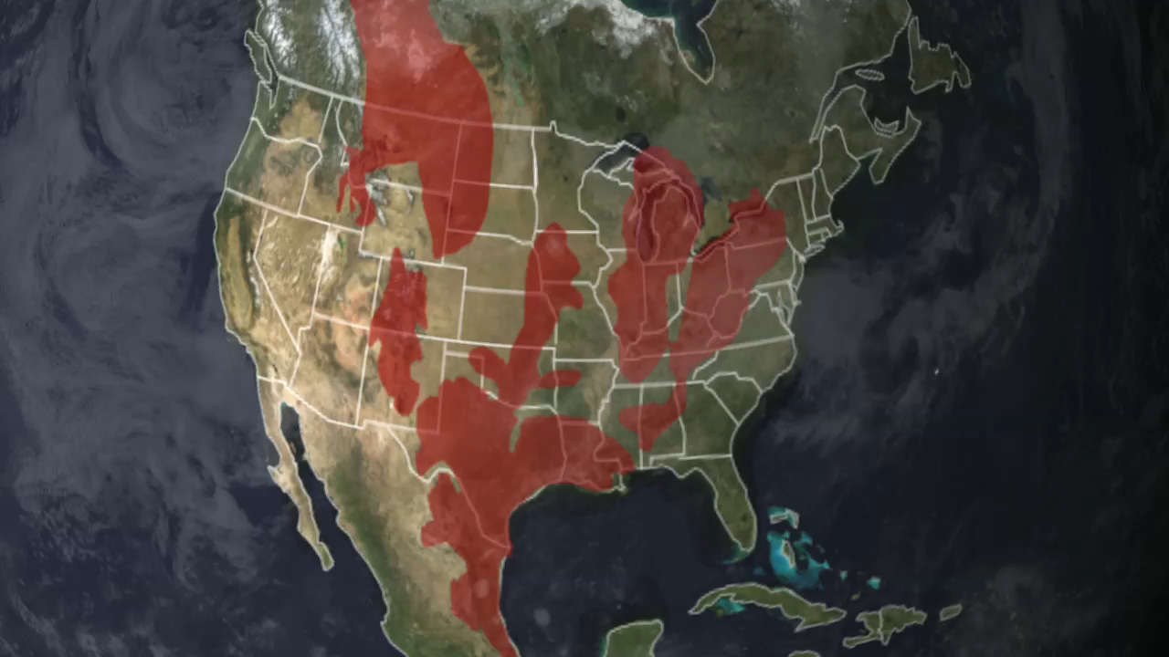
Uncoventionals 101– U.S. Tight Oil and Shale Gas

Slide 6
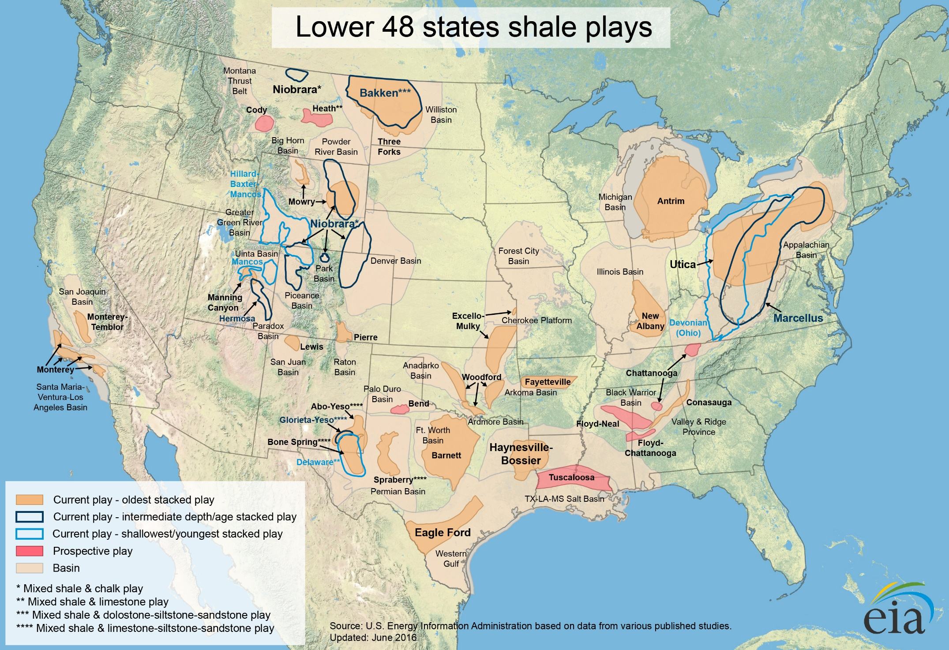
Data source: EIA
U.S. shale gas and tight oil resources are widespread but production is concentrated in key plays.
95% of recent U.S. oil/gas production increases came from just 7 key basins
Appalachia
Bakken
Niobrara
Anadarko
Permian
Haynesville
Eagle Ford
Uncoventionals 101– U.S. Tight Oil and Shale Gas

Slide 7
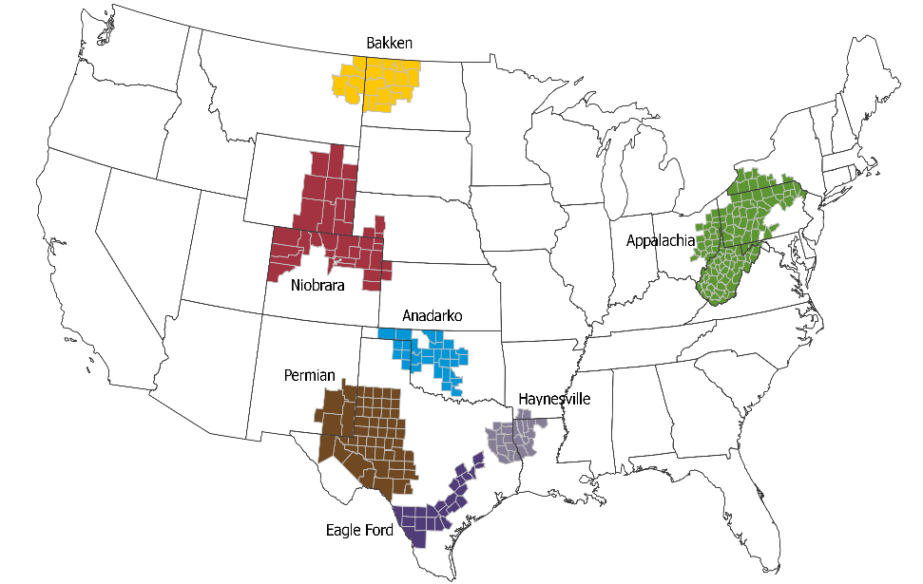
U.S. natural gas exports growing rapidly
Source: Pioneer
The Five Main Tight Oil Plays
Million barrels per day
Permian Basin
Eagle Ford
Bakken
Niobrara
Anadarko
Other plays
Uncoventionals 101– U.S. Tight Oil and Shale Gas

Slide 8
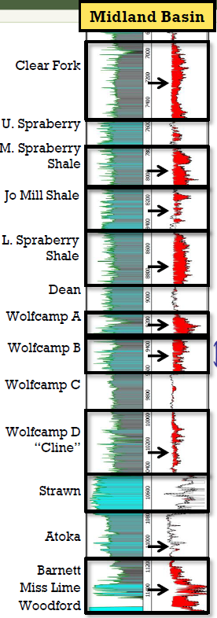
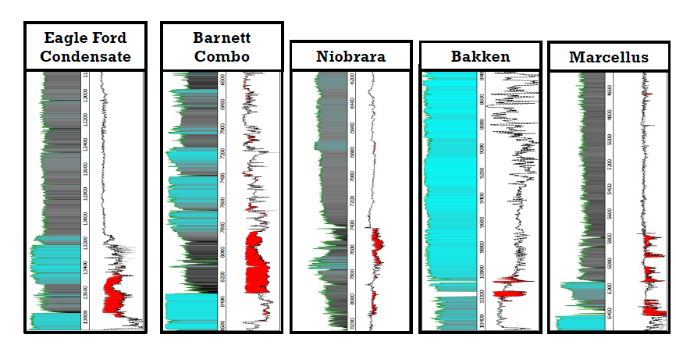
Source: Pioneer
Why the Permian is “Special”
Red intervals indicate hydrocarbons
Petrophysical analysis indicates significantly more oil in place in the Wolfcamp and Spraberry shale intervals in the Midland Basin compared to other major U.S. shale oil plays
Midland Basin contains ~75 BBOE recoverable resource potential and estimates indicates taht the Delware holds similar potential
Source: Pioneer
Uncoventionals 101– U.S. Tight Oil and Shale Gas

Slide 9
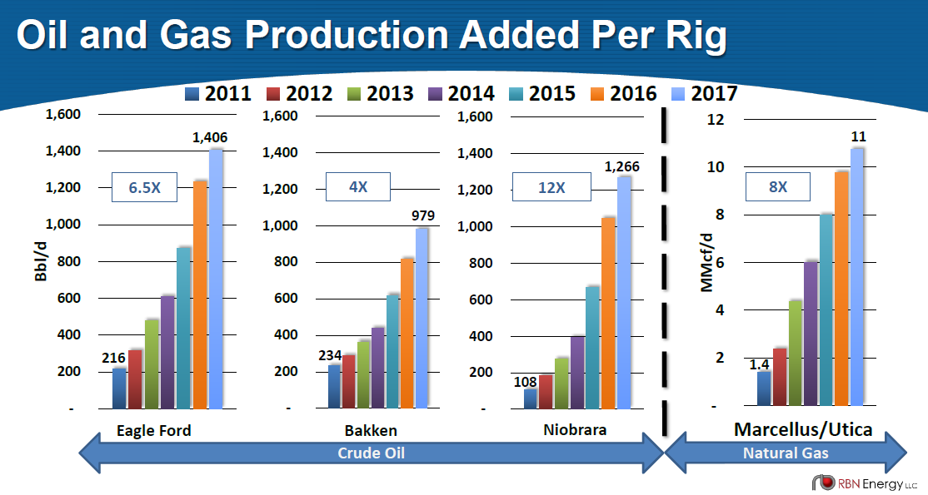
Source: RBN Energy
Uncoventionals 101– U.S. Tight Oil and Shale Gas

Slide 10
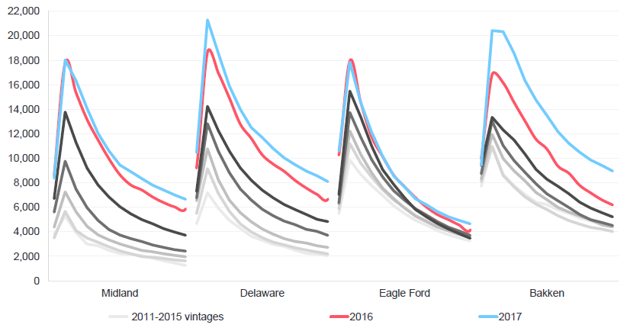
Well Productivity has Risen and Decline Curves Improved
First year oil decline curves for horizontal wells by production start year (median)
Barrels of oil per month
Source: Rystad Energy
Uncoventionals 101– U.S. Tight Oil and Shale Gas

Slide 11
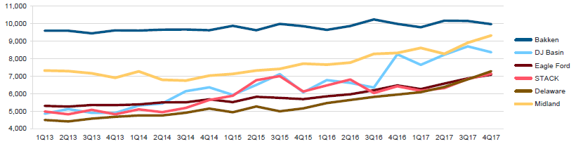
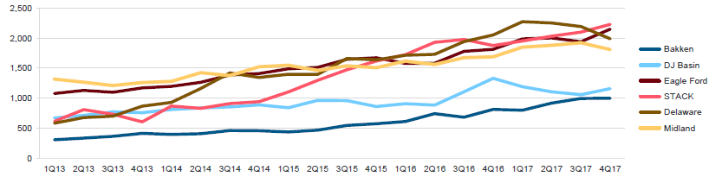
Mostly Driven by Increases in Horse Power, Water, Proppants and Extended Laterals
Average lateral length per completion by quarter and play
Feet
Average proppant intensity by quarter and play
Pounds per foot
Source: Rystad Energy
Uncoventionals 101– U.S. Tight Oil and Shale Gas

Slide 12
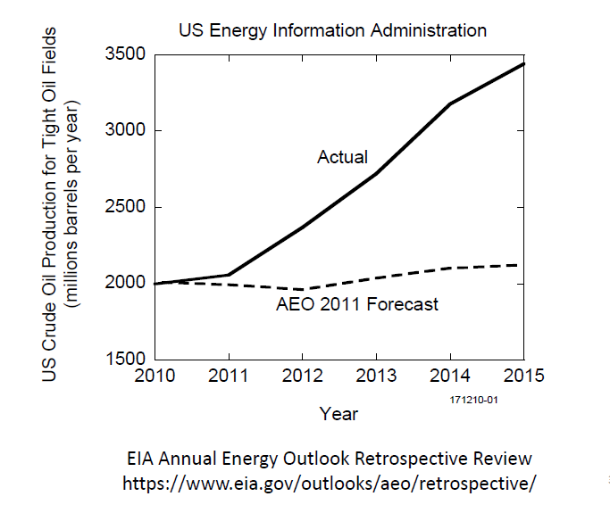
Supply Shocked to the Upside in 2010, What About Going Forward?
Source: Schlumberger
Uncoventionals 101– U.S. Tight Oil and Shale Gas

Slide 13
US Crude, Gas and NGL Production Forecast
Source: RBN Energy LLC
Uncoventionals 101– U.S. Tight Oil and Shale Gas

Slide 14
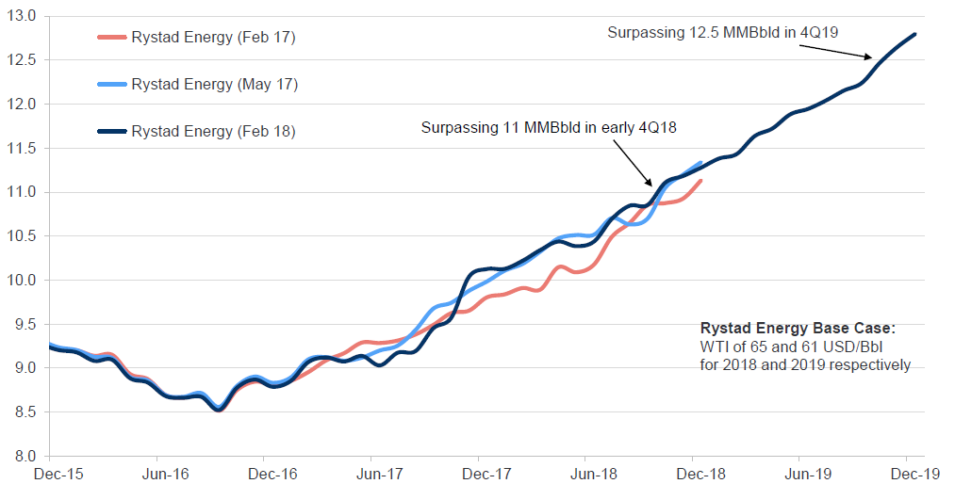
U.S. oil production is set to grow by 2.7 mb/d from Dec-17 to Dec 19
U.S. crude oil and lease condensate production forecast evolution
million barrels per day
Source: Rystad Energy
Uncoventionals 101– U.S. Tight Oil and Shale Gas

Slide 15
US Lower 48 crude oil supply reaches a broad plateau of 11.5 million b/d by 2026
Although the peak has been lowered by about 300 kb/d compared with H1 2017 forecast, we still see strong growth, driven by the Permian
US Lower 48 crude and condensate production
Source: Wood Mackenzie
Uncoventionals 101– U.S. Tight Oil and Shale Gas

Slide 16
Reported Well Gains are Remarkable, but can Sometimes be Misleading
Wolfcamp EUR gains are explosive
But when we study history…..
Source: Wood Mackenzie
Uncoventionals 101– U.S. Tight Oil and Shale Gas

Slide 17
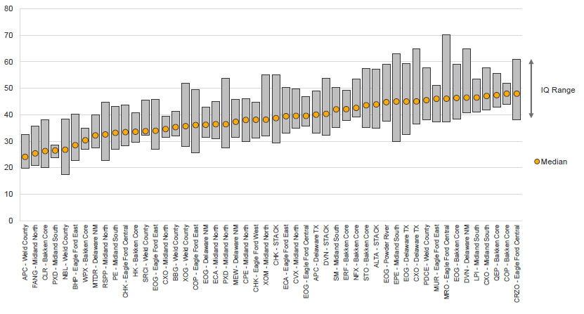
Bottom-line for well economics
Shale players can absorb significant service cost inflation if WTI stays above 60 USD/Bbl
WTI breakeven oil prices in 2016-2017 for 50 most commercial acreage positions with significant activity
Dollars per barrel
Source: Rystad Energy
Uncoventionals 101– U.S. Tight Oil and Shale Gas

Slide 18
The Permian Wolfcamp and Bone Spring account for over half of the total economic Lower 48 resource below $50/bbl (WTI)
Resource potential more than triples from $40/bbl to $60/bbl
Lower 48 tight oil cost curve by play
Source: Wood Mackenzie
Uncoventionals 101– U.S. Tight Oil and Shale Gas

Slide 19
The pre-FID cost curve in 2025: Permian and Eagle Ford dominate
Other themes are competitive, but focus is needed on project execution
Pre-FID and US L48 future drilling production by breakeven in 2025 – by resource theme
Source: Wood Mackenzie
Uncoventionals 101– U.S. Tight Oil and Shale Gas

Slide 20
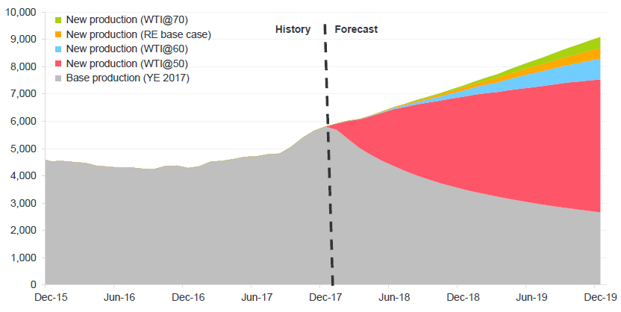
How High/How Long - Price Matters: Elasticity of short-term Shale Production Forecast is
1.6 mb/d difference for Dec-19 between WTI@50 and WTI@70 scenarios
U.S. oil production from horizontal wells : outlook by WTI price scenario
Thousand barrels per day
Source: Rystad Energy
Uncoventionals 101– U.S. Tight Oil and Shale Gas

Slide 21
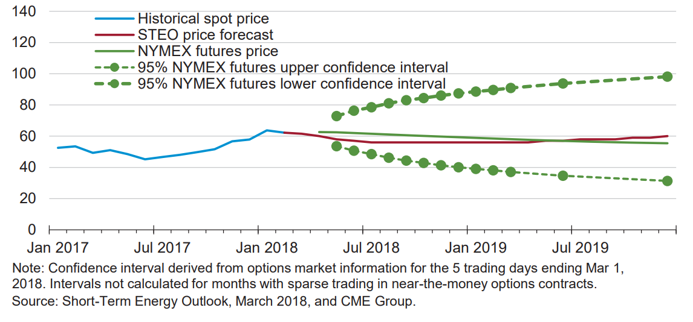
Data source: EIA
West Texas Intermediate (WTI) Crude Oil Price
Dollars per barrel
Uncoventionals 101– U.S. Tight Oil and Shale Gas

Slide 22
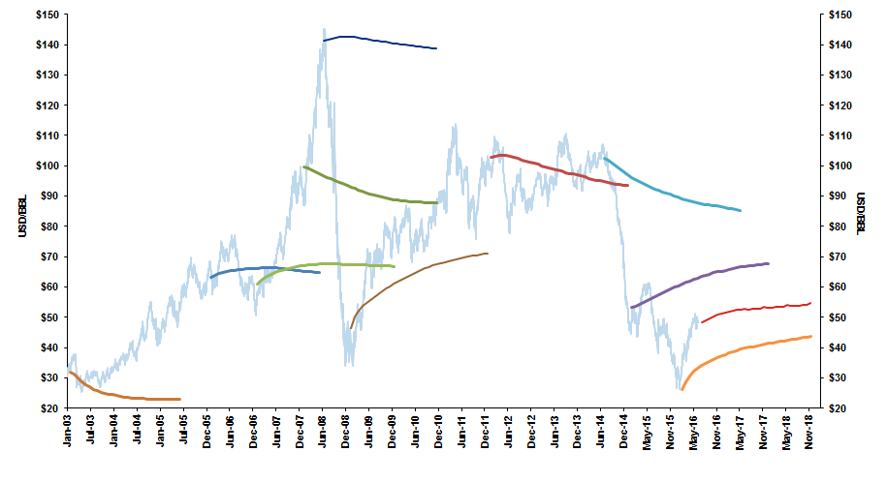
Source: Citi Research
NYMEX WTI Forward Curves Over Time
USD, $/Barrel, 2003 -2016
Forward curve is not a good price predictor, but still functions well for hedging storage costs and requirements
Uncoventionals 101– U.S. Tight Oil and Shale Gas

Slide 23
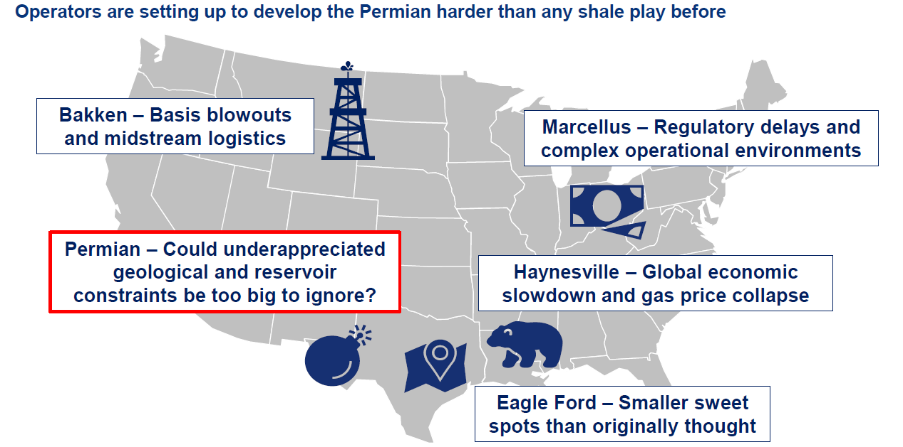
Unexpected Headwinds Have Appeared in the Past
Source: Woodmac
Uncoventionals 101– U.S. Tight Oil and Shale Gas

Slide 24








Challenges
Things to watch out for that will alter the forecasts
Resource Performance: Sweet-Spotting, Spacing, Frack Hits
Frack Crews, Sand, Water, and Trucking Related Costs
Technology and Productivity Improvements – Beyond horsepower, Water and Proppant; Lateral Length
Methane; Water; Seismicity
Adequacy and Timing of Supporting Infrastructure
Tax; Trade (NAFTA); Environmental Regulation; Tariffs and Sanctions
$
Prices; Cost of Capital; Value vs. Volume
Community Opposition and Pendulum Risks

Slide 25
Premium Crude Oil Takeaway Constraints
Source: RBN Energy LLC
Uncoventionals 101– U.S Tight Oil and Shale Gas

Slide 26
Permian Basin – Natural Gas Pipeline Utilization
Source: RBN Energy LLC
Uncoventionals 101– U.S. Tight Oil and Shale Gas

Slide 27
Permian Produced Water
  Historically most Permian PW has been from legacy conventional wells, that come along with a lot of water for each barrel of oil produced.
  But in 2017, unconventional – tight oil – wells caught up.
Source: RBN Energy LLC
Uncoventionals 101– U.S. Tight Oil and Shale Gas

Slide 28
Permian Produced Water
  Conventional wells produce 11-15 times more water than oil (PWOR*=11-15); this produced water is mostly injected back into pressure-depleted oil-producing reservoirs for enhanced oil recovery.
  Unconventional wells have a much lower PWOR of 3-4; This PW cannot be reinjected into the shale reservoirs but must be disposed into salt water disposal (SWD) wells.
Source: RBN Energy LLC
* Produced Water to Oil Ratio
Uncoventionals 101– U.S. Tight Oil and Shale Gas

Slide 29
Access to Finance – Key Messages
For the last 3 years, the resilience of US crude production/producers was aided both by operational improvements as well as the size, liquidity, variety and flexibility of capital markets;
Capital availability predictably varies across price levels, but at $55/b is abundant in all structures; at $60/b liquidity improves substantially and brings additional sources of funding for even marginal producers;
Financial managers estimate some $50-75 billion could be made available to US production; more if “majors” repurpose 2018 funds to US operations;
Persistent funding could well prolong the cycle beyond 2018-19.
Source: IHSMarkit/WoodMac/CSIS
Uncoventionals 101– U.S. Tight Oil and Shale Gas

Slide 30
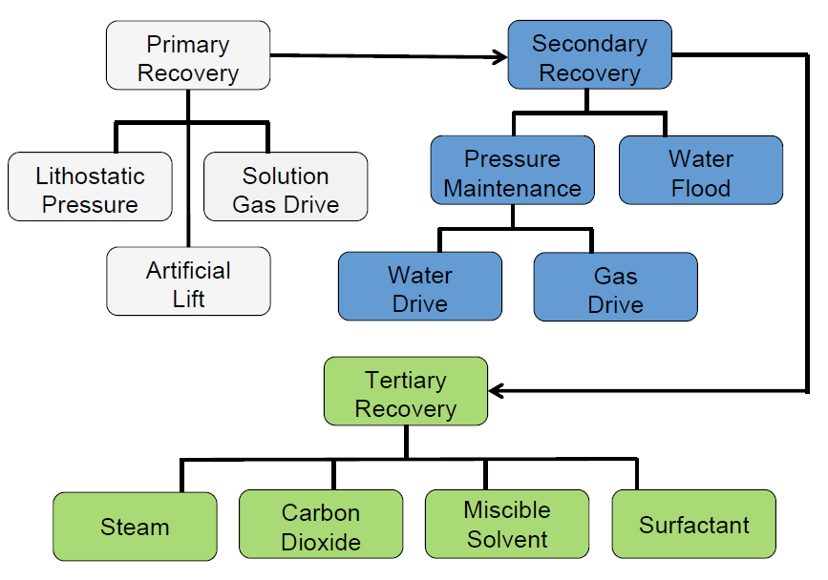
Conventional Oil Recovery Method
Source: Schlumberger
Uncoventionals 101– U.S. Tight Oil and Shale Gas

Slide 31
But, What If??
We are currently producing from “sweet” spots using primary production methods that are decades old; Tight oil recovery factors are currently 5-10% with steep declines and long tails…
There could be a large technology upside in things like:
    Next Generation Technology enhancements - e.g., diverters, variable proppant sizes, better fit “systems”
    Fundamental changes in well completion design work - more efficient fracking, sliding perf sleeves, improved reservoir drainage and fracture complexity, real time analysis and adaptation; new, new reservoir contact paradigms
    Some form of enhanced recovery (cyclic gas injection?)
Uncoventionals 101– U.S. Tight Oil and Shale Gas

Slide 32
Realizing the Full Promise of Shale Resources is Not a Certainty and U.S. Domestic Policy is Important
Technical/Economic Challenges
Environmental/Regulatory/Societal Challenges
  All shales are not alike; application of drilling/reservoir fracturing technology & operational experience matters
  Steep decline rates require ongoing investment and drilling; and repeated fracturing though we should anticipate recovery enhancements
  Cost escalation and low commodity prices limit prospects
  Infrastructure build-out and refinery rationalization
  Well design and management of surface chemicals/materials are the best barriers to protecting water aquifers
  Disclosure of components of fracking
  Scale of water use, treatment & disposal are challenging
  Community Issues – infrastructure, land use, population density, noise, haze, health issues, road congestion and repair need to be addressed
  Seismicity – associated with wastewater injection
  Regulation and enforcement are essential
Uncoventionals 101– U.S. Tight Oil and Shale Gas

Slide 33


President Trump’s World View Could Also Be Disruptive
MAKE AMERICA GREAT AGAIN
National Security & ‎Sovereignty
Deconstruct
Regulatory State
Economic Nationalism
Art of the Deal
Peace thru Strength Rebuild Military and Economy; Strengthen Borders; National Interest Test for Deployment
America First
Create US jobs; Cut
better trade deals;
Energy “Dominance;” redirect foreign aid to support US goals
Transactional; sees opportunities in chaos; employs linkage for leverage; views
Allies/Foes on US terms; bilaterals
Investment Drives Economics; goal TO Reduce burdensome regulation & taxes;
Ignore/rewrite int’l “rules of the road”
Uncoventionals 101– U.S. Tight Oil and Shale Gas

Slide 34
So What Could Alter the Forecasts?
Resource Over/Under Performance?
Technology Advancements, including Disruptive Technologies in Competing Areas, including Demand/Fuel Choices
Commerciality/Economics/Energy Prices & Costs
Investment Climate for Participants
Timing/Expense of Infrastructure Buildout
Public Sentiment – License to Operate (upstream & downstream)
Geopolitical and/or Catastrophic Events/Accidents
Policy & Regulations; Domestic and Global
Uncoventionals 101– U.S. Tight Oil and Shale Gas

Slide 35
About Us
The CSIS Energy & National Security Program is a leader in understanding and analyzing the shifting global and domestic energy landscape. Our approach seeks to analyze and explain the intersection of policy, markets, and technologies. The team is comprised of scholars with a wide range of professional experience in the private and public sectors as well as firsthand regional expertise, who work together to formulate innovative yet pragmatic policy recommendations.
Continuing its collaboration with leaders in industry, government, academia, and nonprofits, the CSIS Energy & National Security Program has events and projects designed to help decision-makers craft smart energy policies that balance economic, environmental, and security priorities.
Notes:
- Non-Profit, Bipartisan, Centrist American Policy Research Institution (“think tank”), founded in 1962
Core Mission: Provide rigorous, independent, thoughtful analysis to help policymakers make better informed decisions
Also mobilize expertise, build networks, convene public and private workshops and sessions to catalyze action and help shape the policy agenda
Of 6,800 think tanks globally, CSIS rated #1 for Defense & National Security for the past 6 years
…and do that on the strength of 200+ full time scholars with varied public and private sector backgrounds & expertise
Plus a wide range of non-resident affiliates
Program areas range from International Affairs/National Security to Global Health, Energy, Trade, Cyber and Regional Expertise
Trustees and Advisory Boards include a “Who’s Who” of foreign & public policy thought leaders as well as philanthropists and corporate executives
Funding comes from government, foundations, individuals, and corporate sponsors
Reports and projects available to the public and we retain intellectual control over content
Available through the internet, social and print media, podcasts/itunes, and expert testimony before Congress

Slide 36
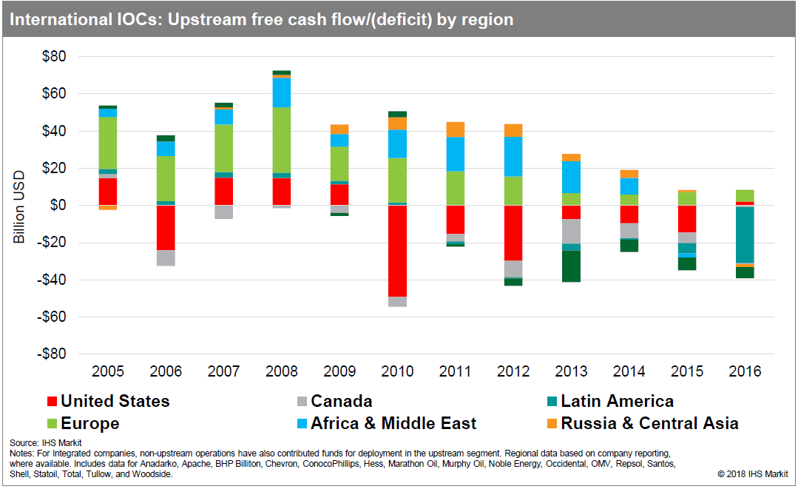
Finding Ways to Fund Investment in the US
Capital inflow into North America shale will create challenges for long cycle project sanctioning
Source: IHS Markit
Uncoventionals 101– U.S. Tight Oil and Shale Gas

Slide 37
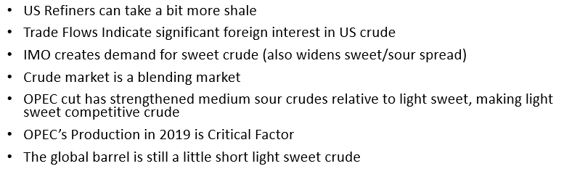
Conclusions- Triangulating Results
Source: ESAI Energy
Uncoventionals 101– U.S. Tight Oil and Shale Gas

Slide 38
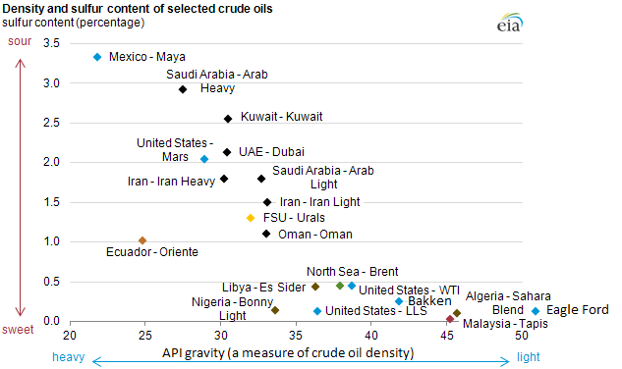
Crude Oil Characteristics Vary
Uncoventionals 101– U.S. Tight Oil and Shale Gas
Notes:
Can we color Bakken, EF, LLs and WTI differently to stand out? Price impact of additional barrels; KSA lock with LTcontracts

Slide 39
Tale of Two Pathways: 2018-2019
Disruptive Events
US/other production increase puts downward pressure on prices and requires additional OPEC cuts
Demand growth increases
Geopolitical events (Venezuela?) remove barrels from the market
Iranian, Russian sanctions; trade wars disrupt supply/demand?
Environmental opposition to FFs impedes infrastructure and new investment
Isolationism and new regional alignments
Price Improves, but…
OPEC/non-OPEC cuts successfully tease out excess inventory
But higher prices, lending and capital flows/spend stimulate new and quick cycle output additions
And if Demand growths slows…
OPEC alliance erodes as member nations chase market share and revenue output; Nigeria and Libya outperform, Iran breaks ranks
Uncoventionals 101– U.S. Tight Oil and Shale Gas

