Slide 1
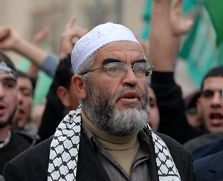
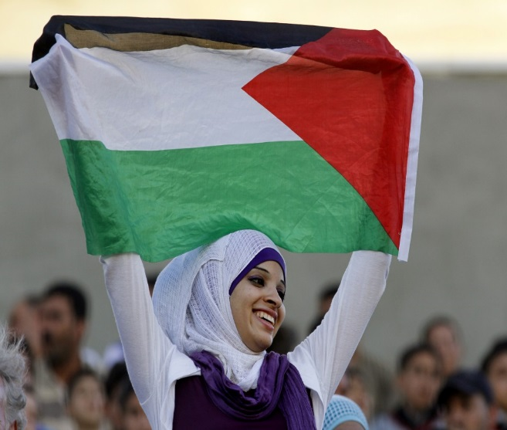
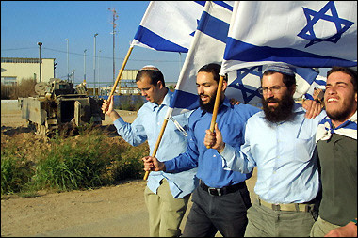
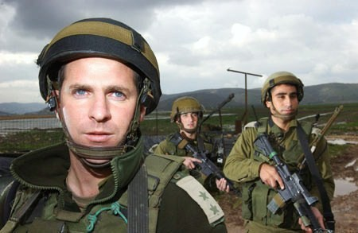

المجتمع والسياسة والأمن في إسرائيل Society, Politics, and Security in Israel חברה פוליטיקה וביטחון ישראלי

Slide 2
Objectives
Examine basic political structure
Understand issues that divide Israeli society
Analyze security and strategic environment
Look forward at challenges to current strategy

Slide 3
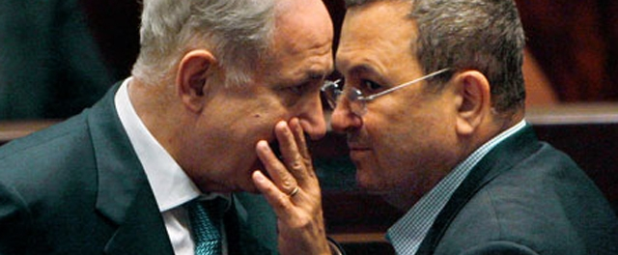
Politics

Slide 4
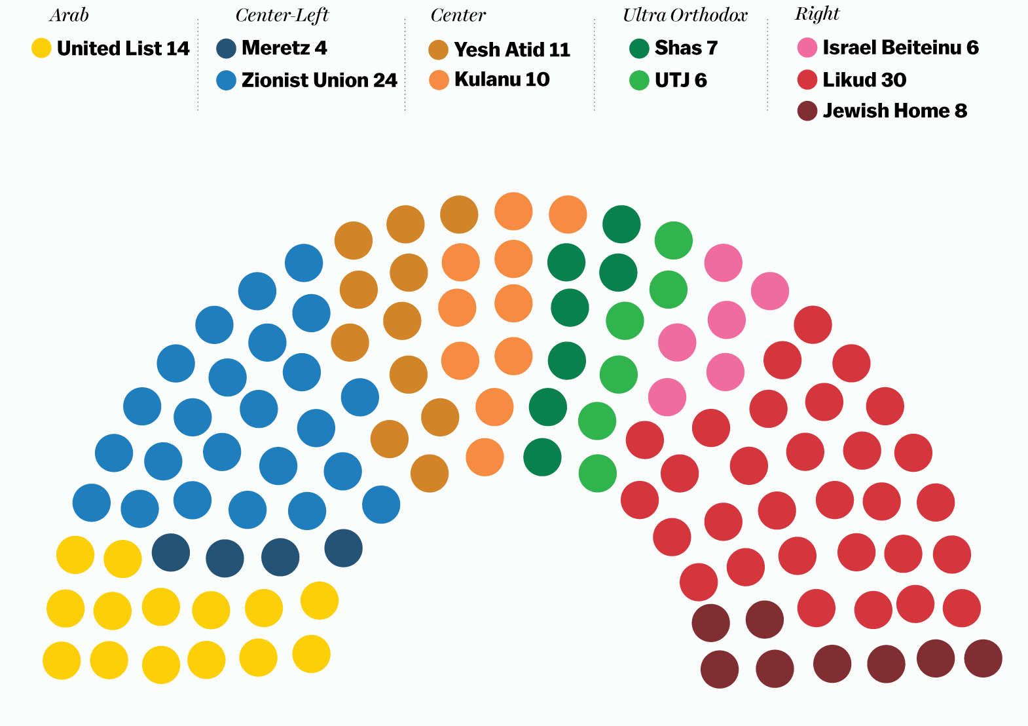

Slide 5
Fragmented Political System
10 political parties serving in parliament
Require 61 seat majority out of 120
Coalition governments
Competing interests and ideologies in same coalition
Average lifespan is 25 months

Slide 6
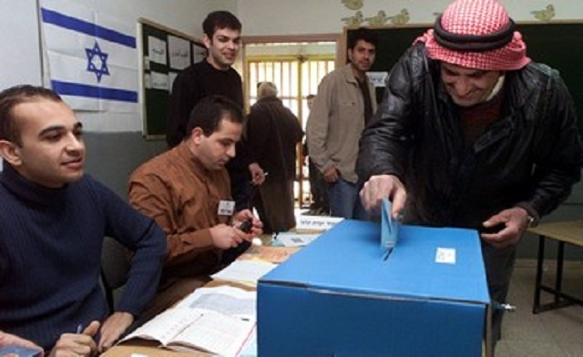
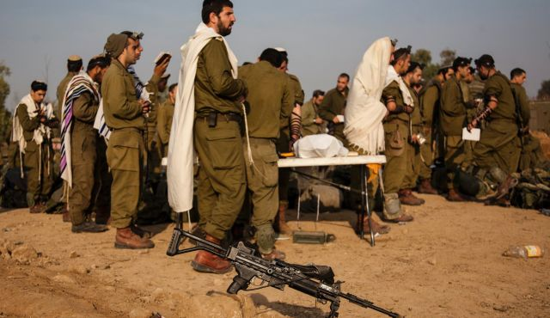
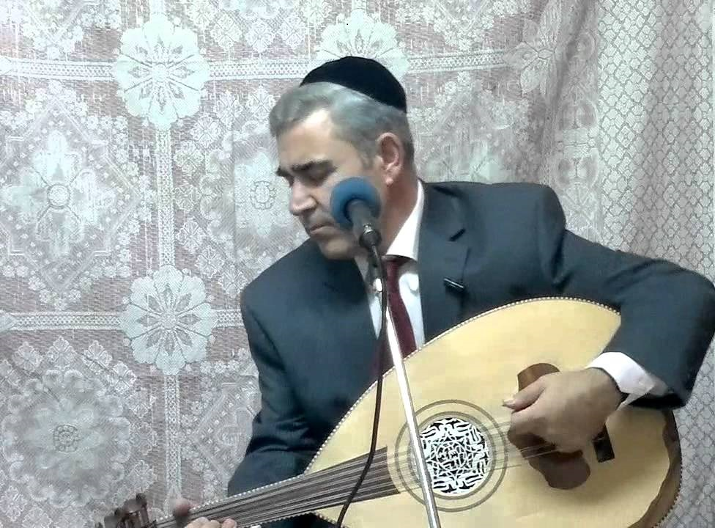
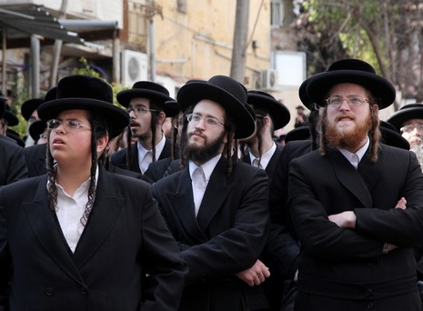
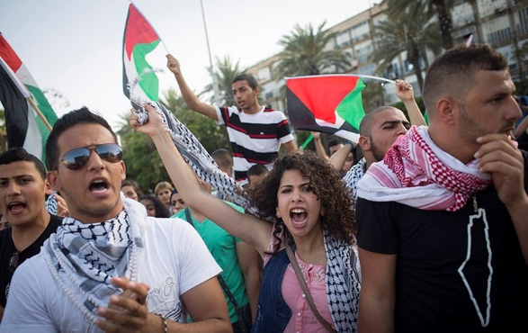

Slide 7
Complex and Diverse Society
Jewish 5,931,000
Arab 1,623,000
Other 327,000
Total 7,881,000
Source: Central Bureau of Statistics, Israel

Slide 8

Identity Crisis
Democratic and Jewish
Jewish majority
Jewish state based on religious law
Democratic/bi-national
Liberal/social democratic
capitalist

Slide 9
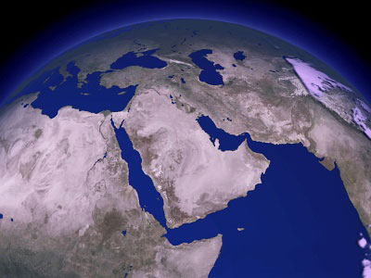
Geopolitical Shifts and Challenges
Unpredictable geopolitical environment
Erosion of strong state systems: Syria, Iraq, Libya
Rise of non-state actors
Insurgencies on borders
Daesh/Al Qaeda

Slide 10
The Iranian Axis
Long-term threat = Military nuclear capability
Denies Israel monopoly on the use of unilateral force
Covert-intelligence campaign
Short-term threat = Transforming Syria into Iranian satellite
Immediate threat kilometers away from Israeli borders
Constant military campaign

Slide 11
The New Syria
Iran’s long term presence
Assad has won
The Russian factor
Arena for external rivalries and proxy battles

Slide 12
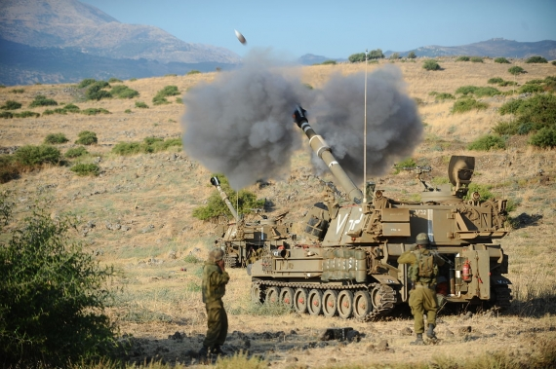
Military Strategy
Deterrence
Red lines
Respond to every military incident
Prevent delivery of sophisticated weapons

Slide 13
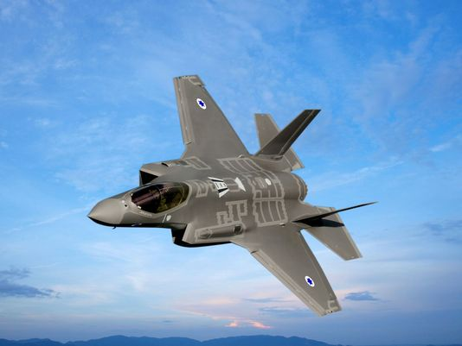
Strategic Limitations
Miscalculation
Overemphasis on Military
Conflict Management

Slide 14
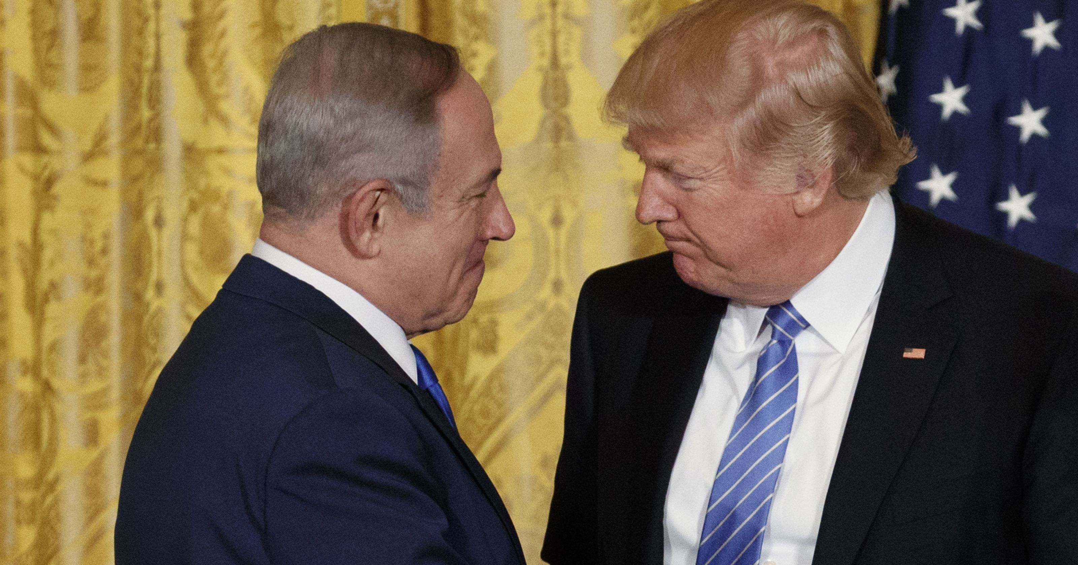
US-Israel Ties: Unbreakable or Unshakeable?

Slide 15
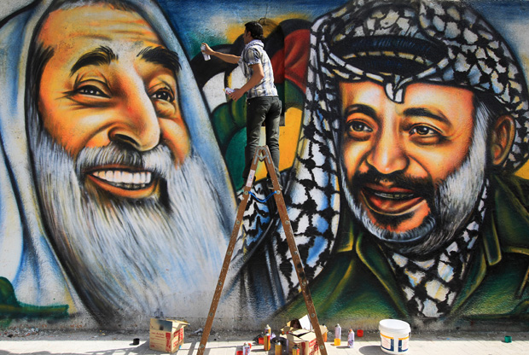
What about Palestine?

Slide 16
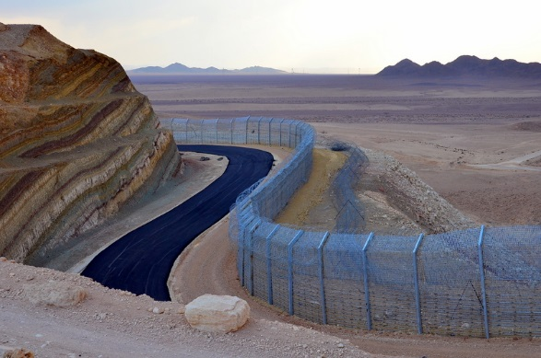
The Road Ahead?

