Slide 1
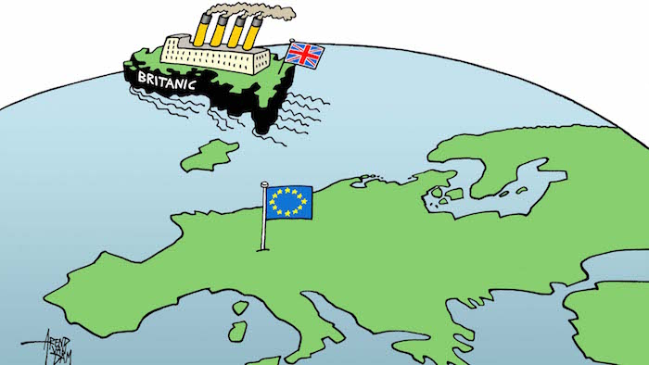
  A European House Divided: Europe’s Future Considered

Slide 2
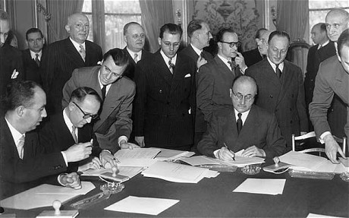
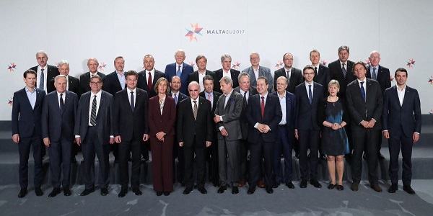
From Six to Twenty Eight
EU stands at 28 member states. The 2009 Treaty of Lisbon enhances security cooperation through Common Security and Defense Policy (CSDP)
Signing of the Treaty of Paris (1951): Creation of the European Coal and Steel Community

Slide 3
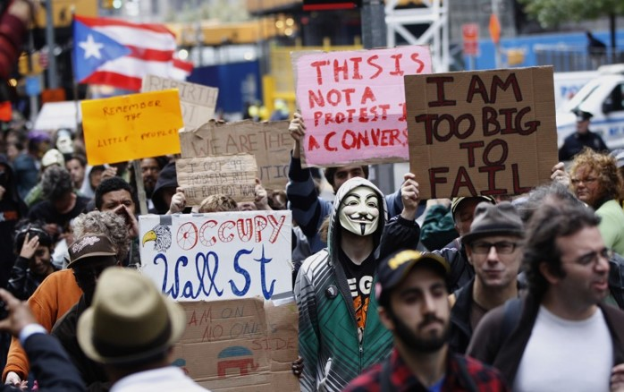

Global Financial Crisis and the Great Recession

Slide 4
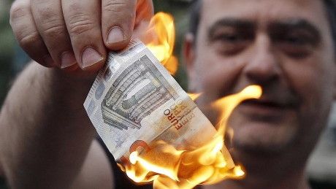
Greek Debt Crisis and Economic Stagnation

Slide 5
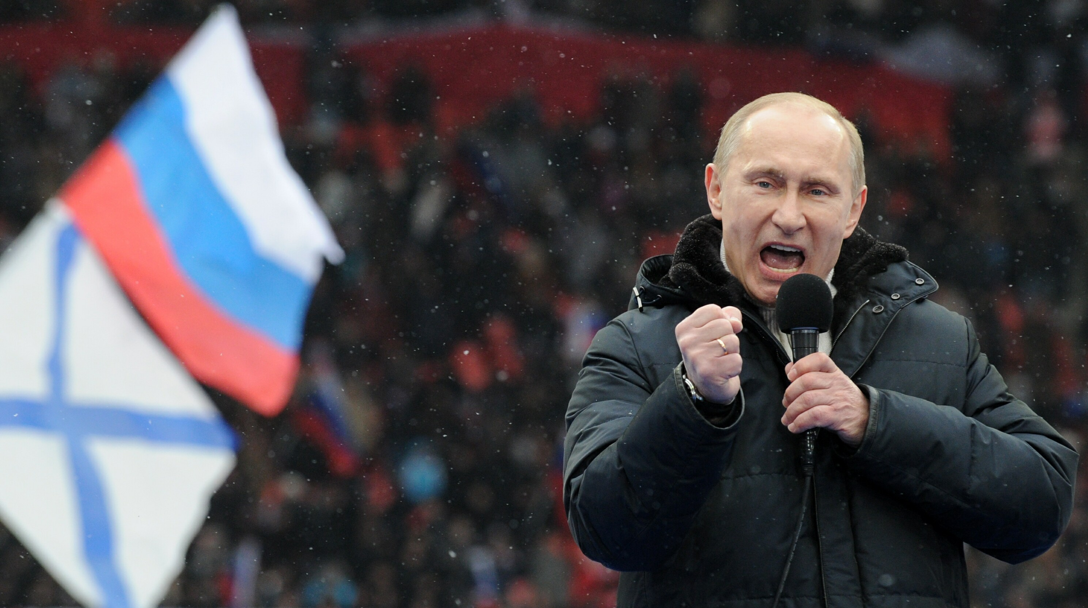
Putin’s Revanchist Russia

Slide 6
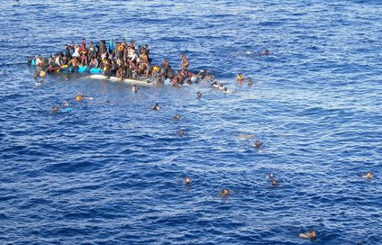
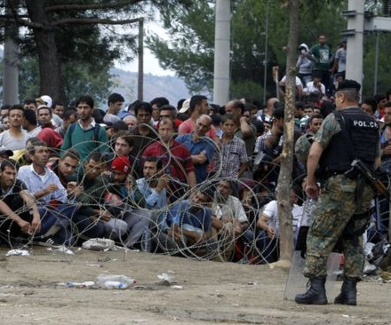
European Migration Crisis

Slide 7

‘Brexit’ Referendum Succeeds

Slide 8
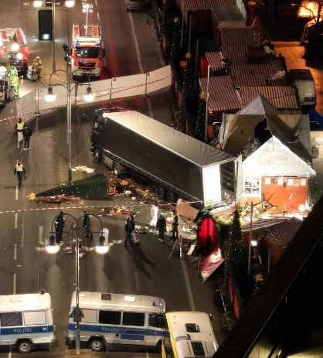
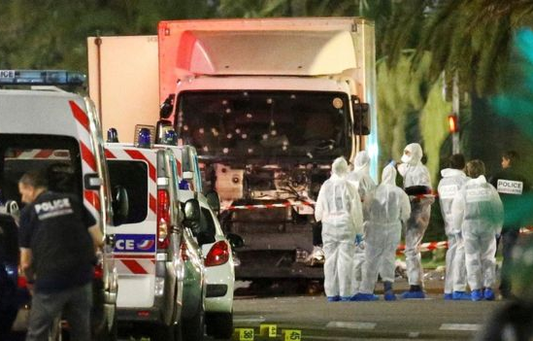
Europe’s Terrorist Attacks

Slide 9
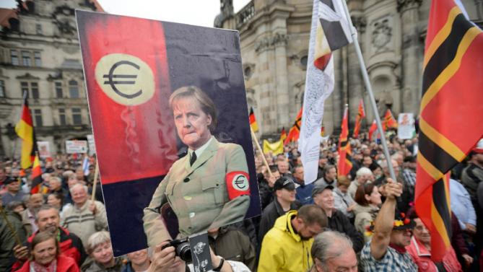
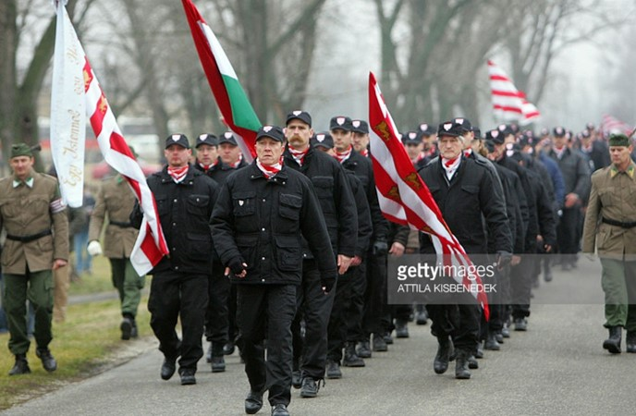
Populism and Nationalism

Slide 10
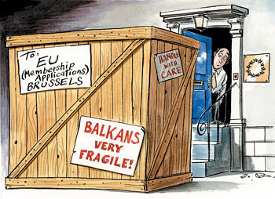
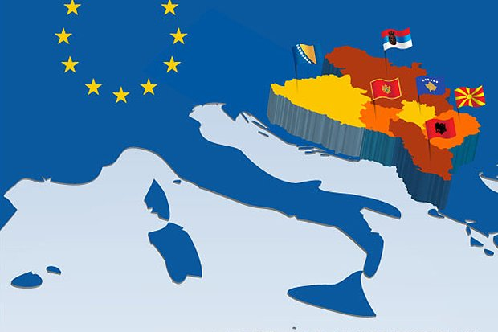
The Western Balkans

Slide 11
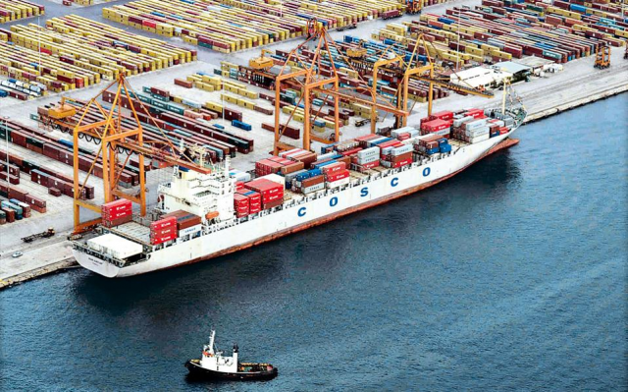
China’s Footprint in Europe
Notes:
Challenges for the transatlantic partnership: free trade, security cooperation, Brexit, Russia

Slide 12
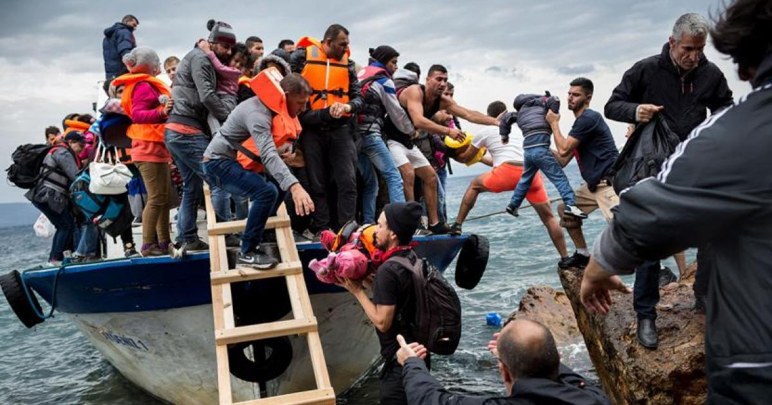

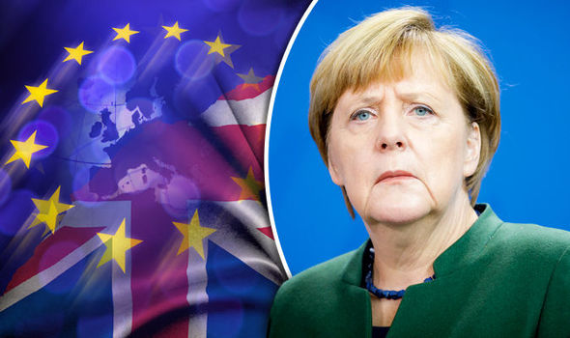
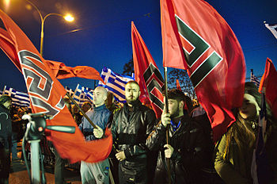
North vs. South; East vs. West: A Divided Europe

Slide 13
For more information:
https://www.csis.org/regions/europe

