Slide 1


The Changing Energy Landscape
April 11, 2018
SAMDS Spring 2018 Program
Sarah O. Ladislaw
Senior Vice President and Director
Energy and National Security Program

Slide 2

Energy Transitions

Slide 3
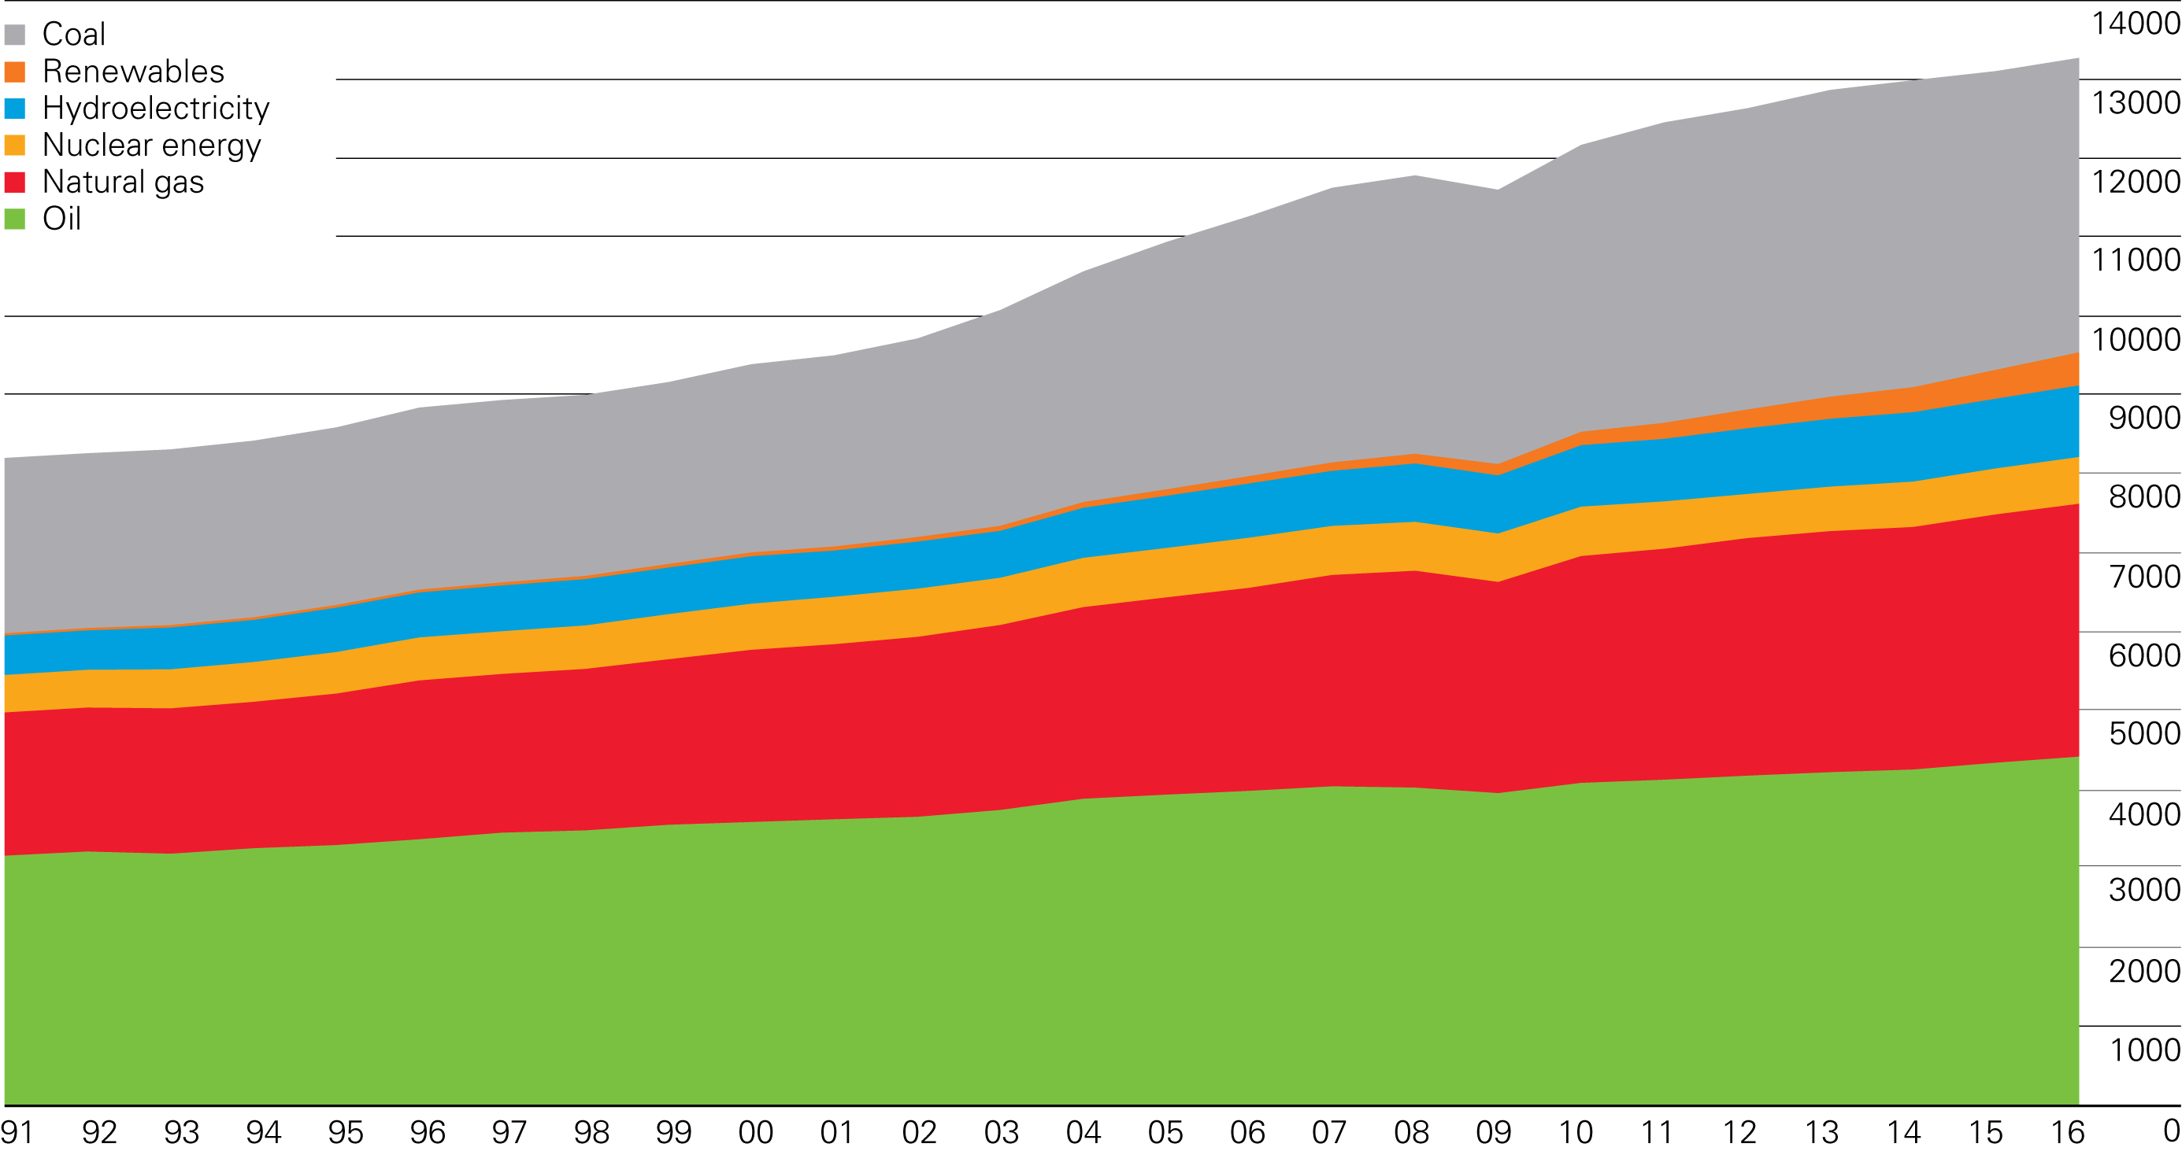
The energy system is so big that big changes can seem small...
Primary energy world consumption
Million tonnes oil equivalent
Great Recession
Notes:
Two things to note:
Fossil fuels have and continue to make up the majority of the energy mix
The pace of energy demand growth picked up in 2003 due to China

Slide 4
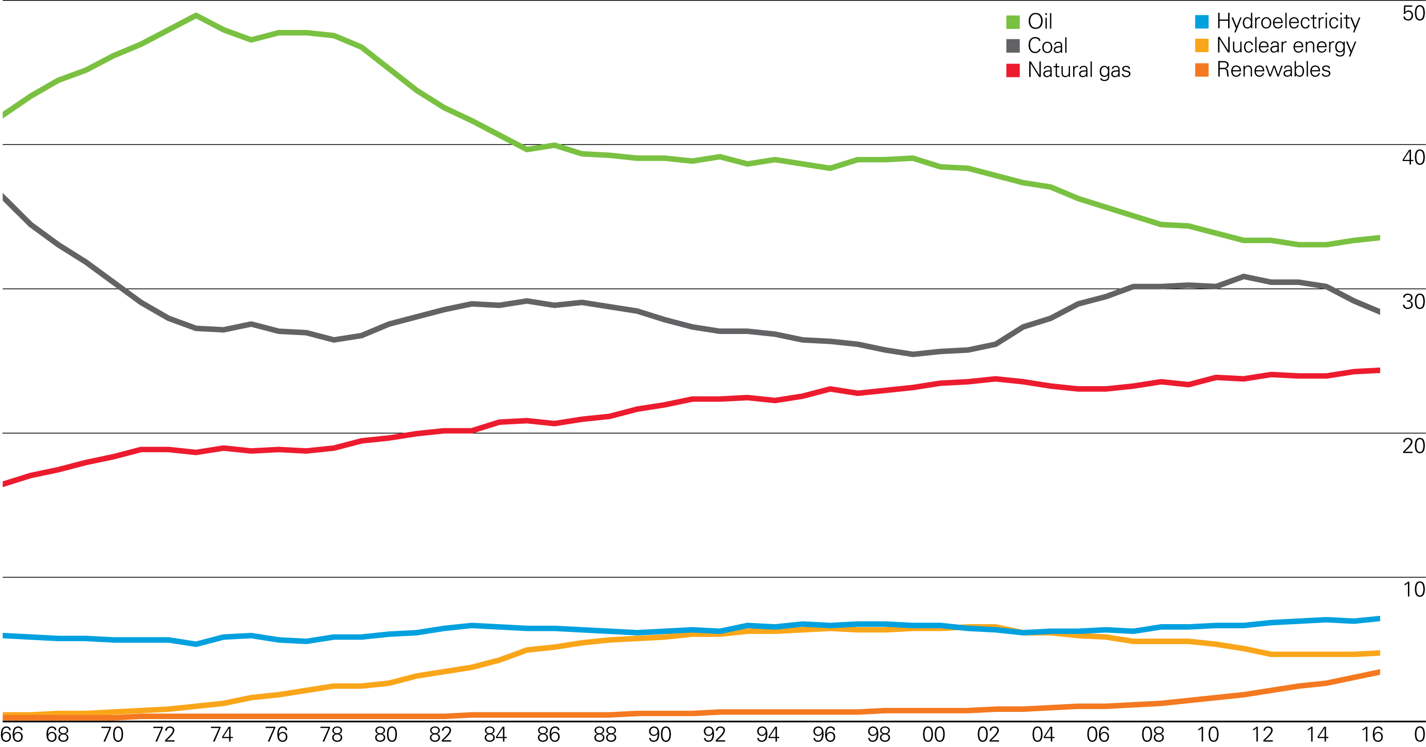
Shares of energy in the fuel mix are occurring…
Shares of global primary energy consumption
Percentage

Slide 5
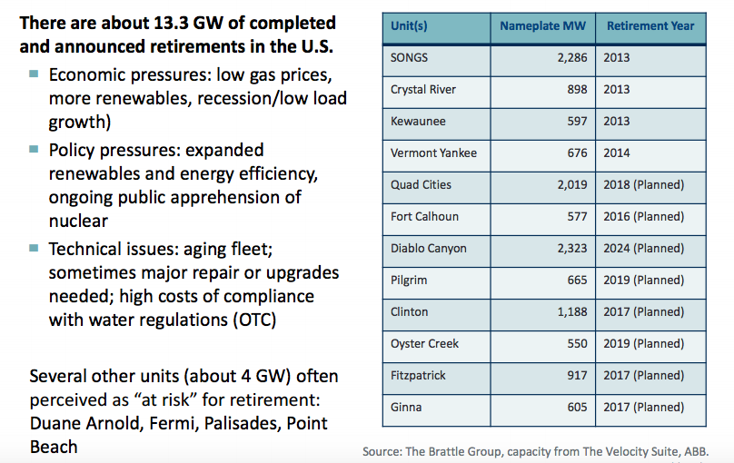
Even small changes can have big consequences…

Slide 6

Energy Outlook
Notes:
AREAS OF CONSENUS IN OUTLOOK

Slide 7
Data source: EIA
Global Primary Energy Consumption by Source
Electric vehicles; fuel switching; efficiency gains
Petroleum and other liquids
Less coal likely means more gas
More rapid global phase out of coal
Coal
Natural gas
Forecasts have consistently underestimated renewables growth
Renewables
Changing attitudes on nuclear
Nuclear
The Changing Energy Landscape
Notes:
Oil: Growth of EVs, greater fuel switching
Coal: More rapid global phase-out of high-carbon fuel
Nuclear: Growing backlash after Fukashima

Slide 8
All Energy Demand Growth Will Come From Developing Economies
Population
Million people
Per capita GDP
Thousand dollars
Energy intensity
Thousand Btu per dollar
Primary Energy Demand
Million Tonnes of Oil Equivalent
Non-OECD
OECD
Data source: EIA & IEA
The Changing Energy Landscape
Notes:
Although population and per capita output continue to rise, energy and carbon intensity are projected to continue to fall in the EIA Reference Case

Slide 9
Global Primary Energy Consumption by Region
Africa
Middle East
Non-OECD
Americas
Europe
and Eurasia
Asia
OECD
Data source: EIA
The Changing Energy Landscape
Notes:
Slide of demand map

Slide 10
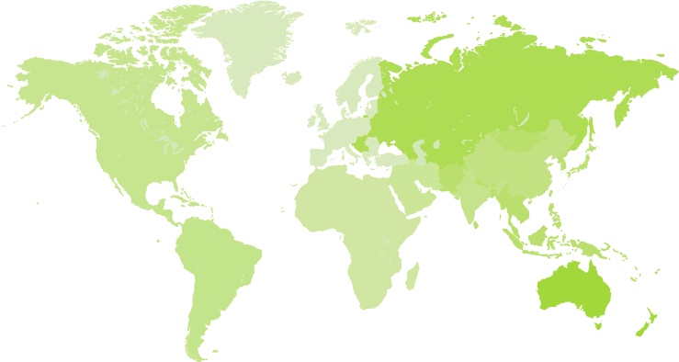
Data source: IEA
Change in Energy Demand by Region
2016-40 (Mtoe)
Europe
-200
135
Eurasia
United States
-30
480
China 790
Japan
-50
Middle East
485
India 1 005
Southeast
Asia
420
Central and
South America
270
Africa
Old ways of understanding the world of energy are losing value as countries change roles
The Changing Energy Landscape

Slide 11
Renewables and Natural Gas Meet Much of the Growth
World electricity generation by fuel
Trillion Kilowatt-hours
Share of net electricity generation
Percent
Liquids
Nuclear
Natural gas
Coal
Renewables
Data source: EIA
The Changing Energy Landscape
Notes:
In the EIA Reference Case, renewables and natural gas provide much of the growth in electricity generation with their combined share of the total rising to 57% in 2040
China, India & the US lead the charge for solar PV, while Europe is a frontrunner for onshore & offshore wind: rising shares of solar & wind require more flexibility to match power demand & supply

Slide 12
Wind and Solar Dominate Renewables Growth
World net electricity generation from renewables
Trillion Kilowatt-hours
Share of renewable energy
Percent
Other
Geothermal
Solar
Wind
Hydropower
Data source: EIA
The Changing Energy Landscape
Notes:
Wind and solar dominate growth in renewables and represent two-thirds of related capacity additions by 2040

Slide 13
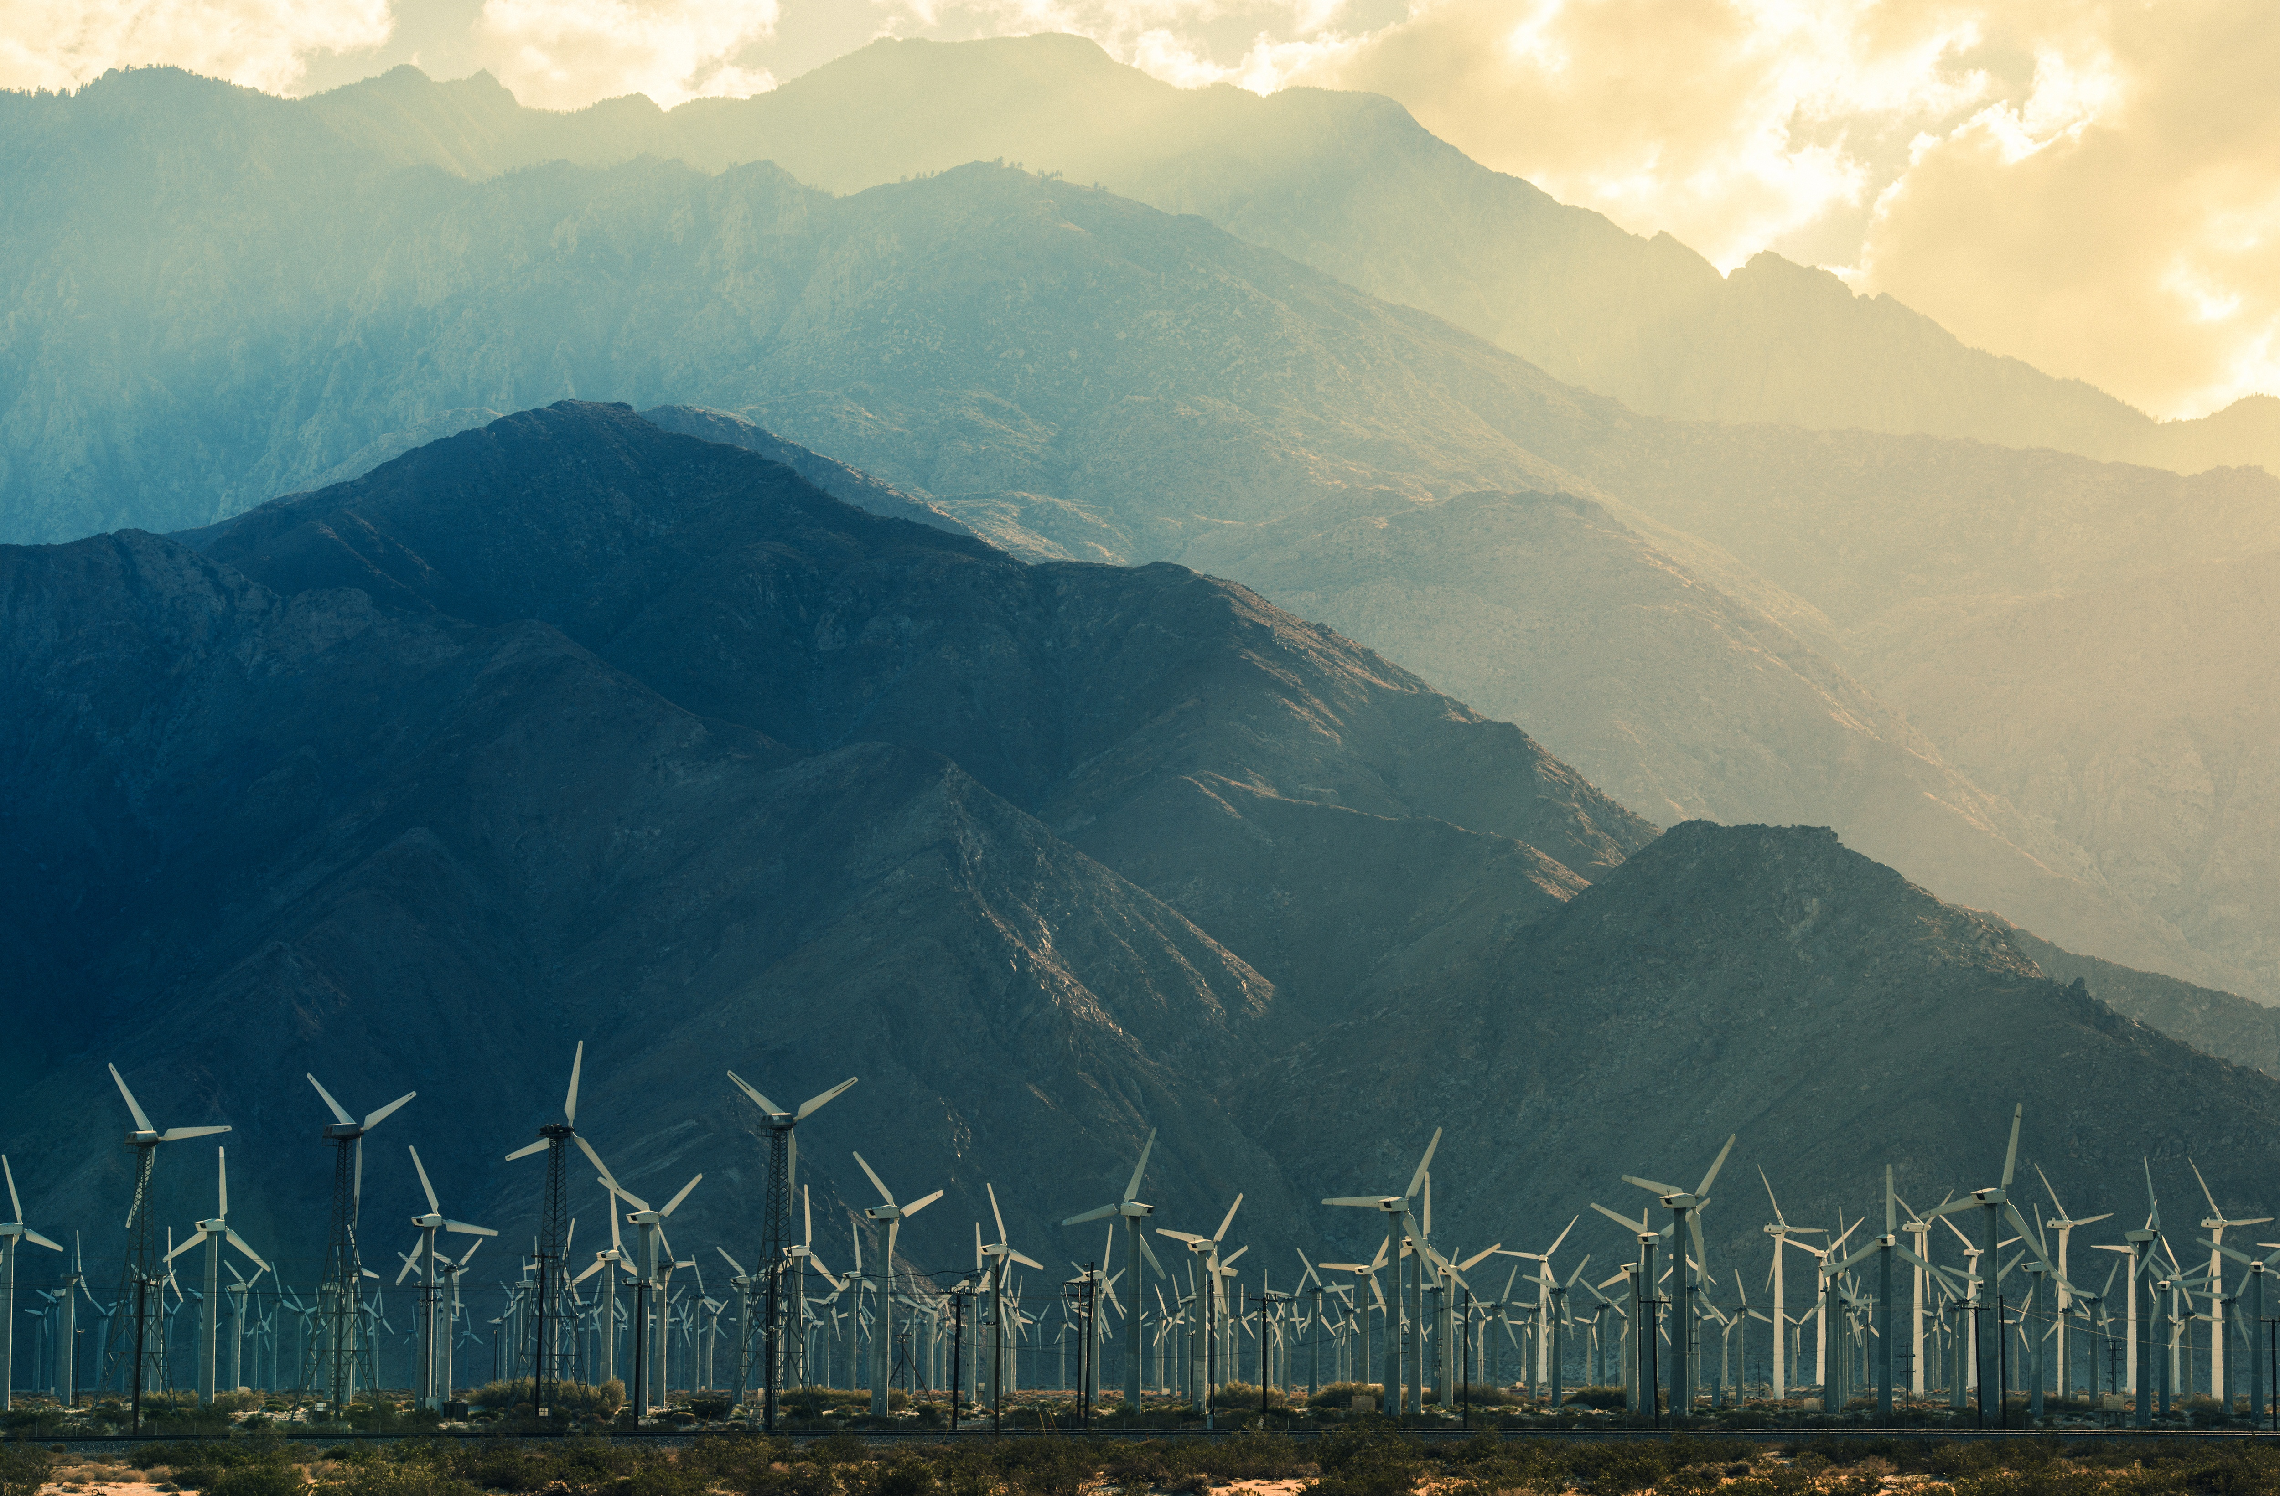
Uncertainties

Slide 14
Areas of Risk, Opportunity, and Uncertainty
Economic optimism masks potential headwinds as near-term energy demand growth picks up pace and energy-intensity of economic growth an area of increasing importance
Oil and gas markets continue toward a fragile rebalance and, absent a supply disruption, prices likely to remain lower for longer, even with extended OPEC agreement
Technological, policy, and market changes continue to reshape established and developing electric power sectors in terms of generation mix, efficiency, and nature of the grid
Growing consensus that current climate efforts fall short of Paris Climate Agreement as action moves from government policymakers to investors and courts
Resurgence of great power politics and “proxy wars” complicate global engagement
Transnational trends – populism, anti-globalization, radicalization, and migration – undermine institutions, governance and relationships
Economic statecraft, including sanctions and trade, will continue to reshape domestic energy markets, patterns of investment, infrastructure build out, pace of energy development and energy trade flows
Notes:
Quadruple “post” period
Post-Great Recession (2008)
Post-Oil Price collapse (2014)
Post-Paris Climate Agreement (2015)
Post-US Presidential Election (2016)

Slide 15


World Economic Outlook
Global growth has been accelerating since mid-2016, and all signs point to a further strengthening both this year and next.
One fifth of emerging markets and developing countries saw their per capita incomes decline in 2017.
Growth is mostly cyclical - absent reforms, the fundamental forces that had us worried about the “new mediocre”– will remain in place.
The long period of low interest rates has led to a buildup of potentially serious financial sector vulnerabilities. We are seeing a troubling increase in debt across many countries and we need to remain watchful.
“Complacency would be a mistake. We certainly should feel encouraged, yet we should not feel satisfied. ”
Christine Lagarde
Notes:
Since the Great Recession, most of the world’s economies have returned to business-as-usual growth paths, and in 2017 global economic growth was even better than expected at 3.7 percent, compared to an initial IMF forecast of just 3.1 percent IMF, “World Economic Outlook (October 2017)” October 2017.

Slide 16
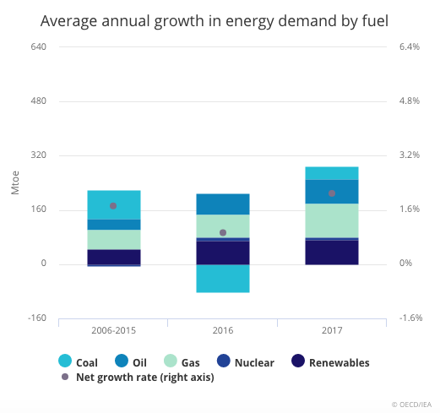
2017: Global energy demand grew by 2.1% - twice the rate of 2016
Fossil fuels met 70% of demand growth and renewables made up 25%
Fossil fuel share remained 81% but gas rose to a record 22% of global energy mix
Energy efficiency improvements slowed down to 1.7% improvement in energy intensity from 2.05 in 2016
China and India alone accounted for 40% of energy demand growth

Slide 17
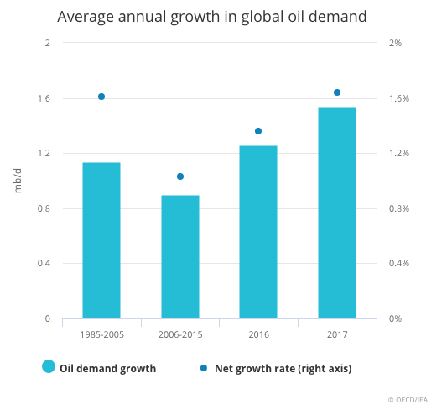
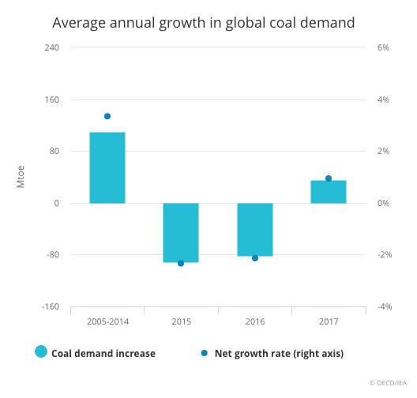
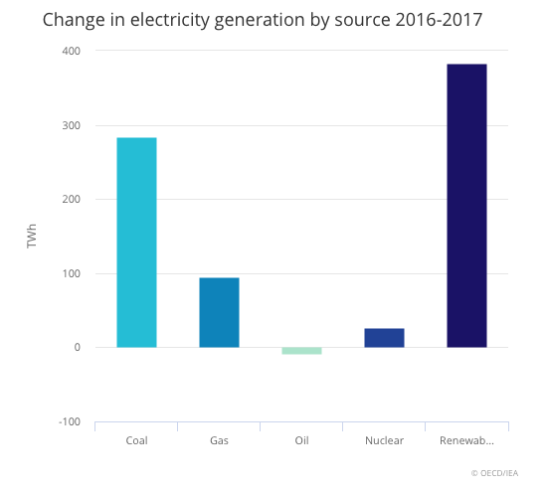
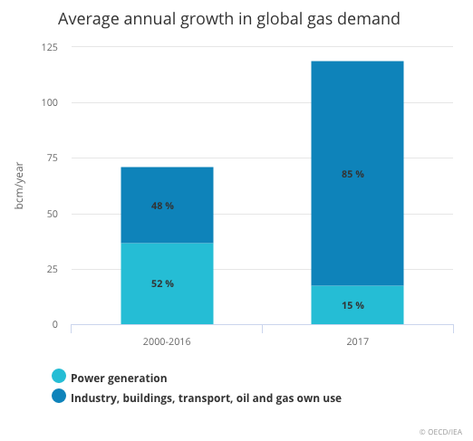
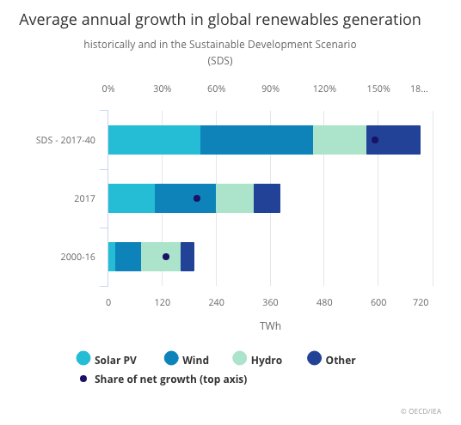
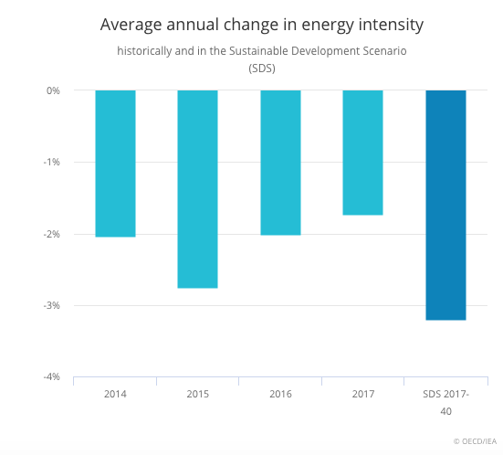
2017: All fuels saw growth, some more robust than others
OIL
COAL
ELECTRCITY
NATURAL GAS
RENEWABLES
ENERGY EFFICIENCY
Notes:
World oil demand rose by 1.6% (or 1.5 million barrels a day) in 2017, a rate that was more than twice the annual average seen over the last decade. An increasing share of sport utility vehicles and light trucks in major economies and demand from the petrochemicals sector bolstered this growth.
Global natural gas demand grew by 3%, thanks in large part to abundant and relatively low-cost supplies. China alone accounted for almost 30% of global growth. In the past decade, half of global gas demand growth came from the power sector; last year, however, over 80% of the rise came from industry and buildings.
Global coal demand rose about 1% in 2017, reversing the declining trend seen over the last two years. This growth was mainly due to demand in Asia, almost entirely driven by an increase in coal-fired electricity generation.
Renewables saw the highest growth rate of any energy source in 2017, meeting a quarter of global energy demand growth. China and the United States led this unprecedented growth, contributing around 50% of the increase in renewables-based electricity generation, followed by the European Union, India and Japan. Wind power accounted for 36% of the growth in renewables-based power output.
World electricity demand increased by 3.1%, significantly higher than the overall increase in energy demand. Together, China and India accounted for 70% of this growth. Output from nuclear plants rose by 26 terrawatt hours (TWh) in 2017, as a significant amount of new nuclear capacity saw its first full year of operation.
Improvements in global energy efficiency slowed down dramatically in 2017, because of weaker improvement in efficiency policy coverage and stringency as well as lower energy prices. Global energy intensity improved by only 1.7% in 2017, compared with an average of 2.3% over the last three years.

Slide 18
Areas of Risk, Opportunity, and Uncertainty
Economic optimism masks potential headwinds as near-term energy demand growth picks up pace and energy-intensity of economic growth an area of increasing importance
Oil and gas markets continue toward a fragile rebalance and, absent a supply disruption, prices likely to remain lower for longer, even with extended OPEC agreement
Technological, policy, and market changes continue to reshape established and developing electric power sectors in terms of generation mix, efficiency, and nature of the grid
Growing consensus that current climate efforts fall short of Paris Climate Agreement as action moves from government policymakers to investors and courts
Resurgence of great power politics and “proxy wars” complicate global engagement
Transnational trends – populism, anti-globalization, radicalization, and migration – undermine institutions, governance and relationships
Economic statecraft, including sanctions and trade, will continue to reshape domestic energy markets, patterns of investment, infrastructure build out, pace of energy development and energy trade flows
Notes:
Quadruple “post” period
Post-Great Recession (2008)
Post-Oil Price collapse (2014)
Post-Paris Climate Agreement (2015)
Post-US Presidential Election (2016)

Slide 19
The Rocky Road to Rebalance
Data source: Reuters
The Changing Energy Landscape

Slide 20
The U.S. Tight Oil Boom
Data source: EIA
Million barrels per day
The Changing Energy Landscape
Notes:
The high-price environment for natural gas and oil in the U.S. in the early 2000s coupled with low interest rates incentivized the industry to explore and produce previously untapped shale resources through the combination of horizontal drilling and hydraulic fracturing. Drilling a vertical shaft to the shale seam, pivoting the drill bit horizontally along oil- and gas-bearing shale zones, and then fracturing the shale along these laterals with a combination of water, sand, and chemicals allowed for tight oil and shale gas to flow into the well. The uptake of these techniques brought tremendous volumes of gas to the domestic market, which not only offset declining supplies from conventional production but led to significant levels of growth in overall terms.

Slide 21
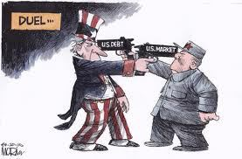
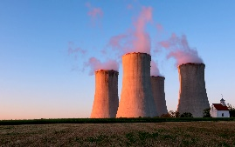
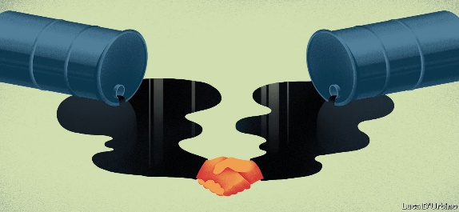



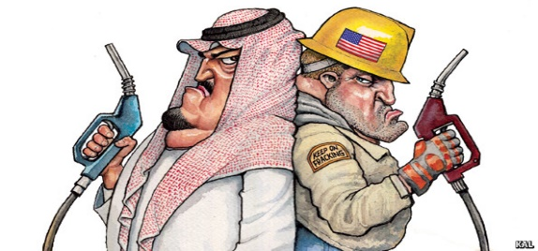


Data source: BP
Global Oil Price Cycle: What’s Next?
Cartoons source: The Economist
Crude oil prices in real 2016 U.S. dollars and nominal U.S. dollars
Annual average price per barrel
Decade of Disorder?
OPEC/non-OPEC Decade?
Lost Decade II?
The Changing Energy Landscape
Notes:
Short-term – upward price pressure on crude prices due to:
Strong U.S. tight oil growth (10.4 mbd in March)
OPEC/Russia supply curtailment
Stock/inventory drawdown
Strong demand growth (discussed earlier)

Slide 22
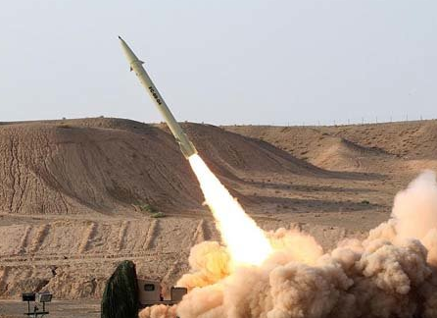
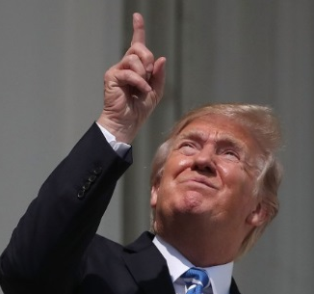
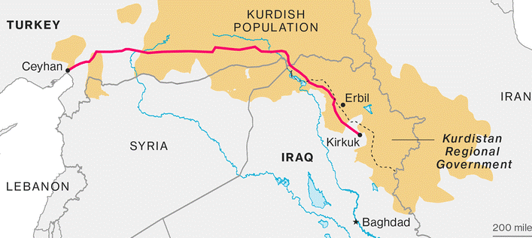




Data source: EIA
Supply side geopolitical risks to oil are ever present
$$$
Iran
2.5 mb/d
Venezuela
1.5 mb/d
Kurdistan
0.5 mb/d
The Changing Energy Landscape
Notes:
-Venezuela production decline has been 24% yoy
-Geopolitical concern over Iran sanctions after May 12th

Slide 23
Uncertainty For Future Oil Demand
Data source: Statoil, Exxon,
CNPC, BP, IEA, EIA,OPEC
Million barrels per day
Fuel Switching
Efficiency Gains
EV Penetration
Petrochemicals
Lower GDP
The Changing Energy Landscape

Slide 24
Uncertainty Drivers For Future Oil Demand
Data source: Statoil, Exxon,
CNPC, BP, IEA, EIA,OPEC
 |  | Forecast
 | Historical
Average of High Demand Forecasts
Fuel Switching
Efficiency Gains
EV Penetration
Petrochemicals
Lower GDP
Average of Low Demand Forecasts
The Changing Energy Landscape

Slide 25
Areas of Risk, Opportunity, and Uncertainty
Economic optimism masks potential headwinds as near-term energy demand growth picks up pace and energy-intensity of economic growth an area of increasing importance
Oil and gas markets continue toward a fragile rebalance and, absent a supply disruption, prices likely to remain lower for longer, even with extended OPEC agreement
Technological, policy, and market changes continue to reshape established and developing electric power sectors in terms of generation mix, efficiency, and nature of the grid
Growing consensus that current climate efforts fall short of Paris Climate Agreement as action moves from government policymakers to investors and courts
Resurgence of great power politics and “proxy wars” complicate global engagement
Transnational trends – populism, anti-globalization, radicalization, and migration – undermine institutions, governance and relationships
Economic statecraft, including sanctions and trade, will continue to reshape domestic energy markets, patterns of investment, infrastructure build out, pace of energy development and energy trade flows
Notes:
Quadruple “post” period
Post-Great Recession (2008)
Post-Oil Price collapse (2014)
Post-Paris Climate Agreement (2015)
Post-US Presidential Election (2016)

Slide 26
The Future is Electrifying
Electricity Generation by Selected Region
2016
Growth to 2040
China
United States
India
European Union
Southeast Asia
Middle East
Africa
2 000
4 000
6 000
8 000
10 000
TWh
India adds the equivalent of today’s European Union to its electricity generation by 2040,
while China adds the equivalent of today’s United States
Data source: IEA
The Changing Energy Landscape
Notes:
India adds the equivalent of today’s European Union to its electricity generation by 2040, while China adds the equivalent of today’s United States
Electricity demand
Fastest-growing form of end-use energy consumption, rising 1.5% per year

Slide 27
Electricity is the Largest End Use of Energy Generation
Sources of global electricity demand growth
World energy consumption by end-use
Quadrillion Btu
Other
Industrial
motors
Electric vehicles
Large
appliances
Connected
& small appliances
Cooling
Data source: EIA & IEA
The Changing Energy Landscape

Slide 28
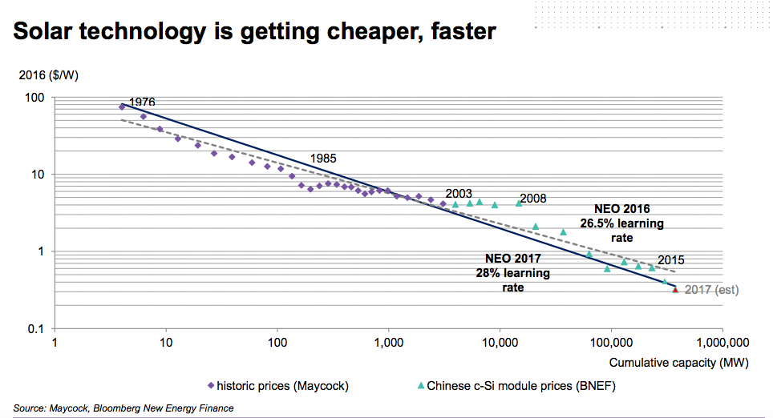

Slide 29
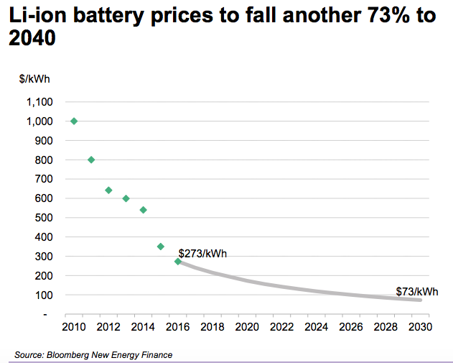

Slide 30
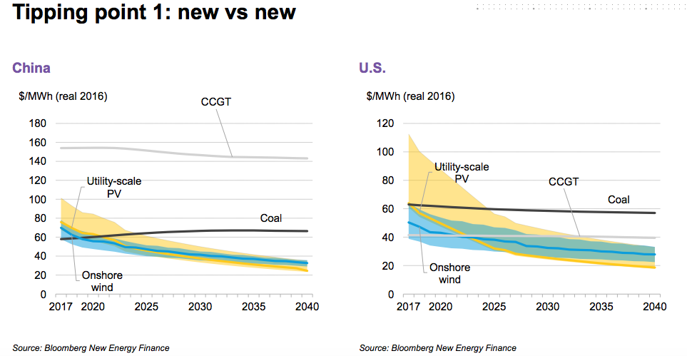

Slide 31
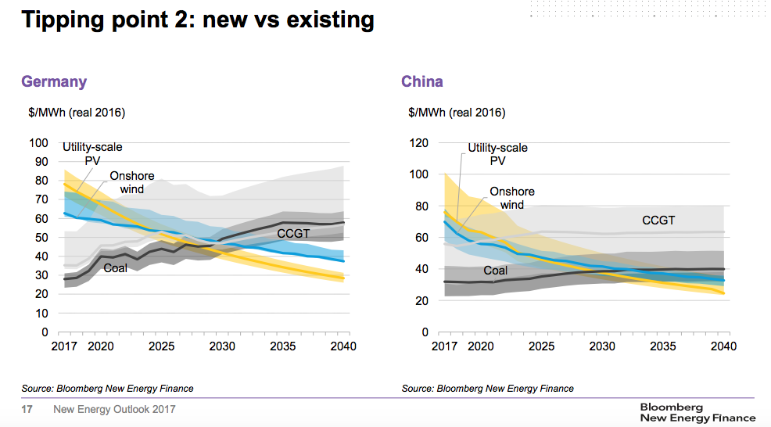

Slide 32
Areas of Risk, Opportunity, and Uncertainty
Economic optimism masks potential headwinds as near-term energy demand growth picks up pace and energy-intensity of economic growth an area of increasing importance
Oil and gas markets continue toward a fragile rebalance and, absent a supply disruption, prices likely to remain lower for longer, even with extended OPEC agreement
Technological, policy, and market changes continue to reshape established and developing electric power sectors in terms of generation mix, efficiency, and nature of the grid
Growing consensus that current climate efforts fall short of Paris Climate Agreement as action moves from government policymakers to investors and courts
Resurgence of great power politics and “proxy wars” complicate global engagement
Transnational trends – populism, anti-globalization, radicalization, and migration – undermine institutions, governance and relationships
Economic statecraft, including sanctions and trade, will continue to reshape domestic energy markets, patterns of investment, infrastructure build out, pace of energy development and energy trade flows
Notes:
Quadruple “post” period
Post-Great Recession (2008)
Post-Oil Price collapse (2014)
Post-Paris Climate Agreement (2015)
Post-US Presidential Election (2016)

Slide 33
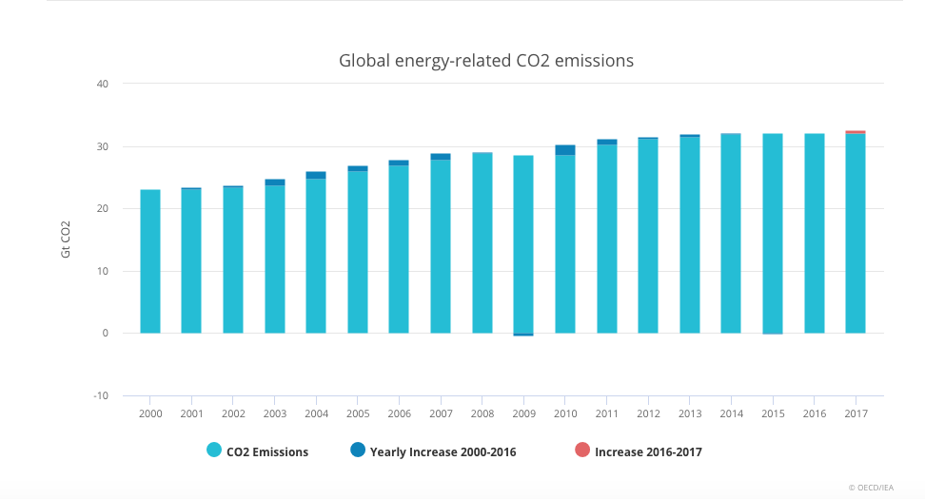
C02 emission grew by 1.4% - a resumption of growth after three years of remaining flat
Notes:
Emissions dropped in United States, United Kingdom, Mexico and Japan. The biggest decline drop came from the United States, mainly because of higher deployment of renewables.

Slide 34




Data source: IEA
Energy and Sustainable Development
Global CO₂ emissions by scenario
Gt
40
New Policies Scenario
30
Sustainable Development Scenario
20
Sustainable Development Scenario
10
2000
2010
2020
2030
2040
The Changing Energy Landscape
Notes:
Climate change causing disruptions, security threats, and creating poverty
Over 1 billion still do not have electricity access Premature deaths from bad air

Slide 35
Source: IEA
A Daunting Challenge…
The Sustainable Development Scenario in 2040
875
2times
million electric
vehicles
more efficient than today
3 250GW
20%
global solar PV capacity
additional gas demand
15% additional investment is required to 2040 to achieve the Sustainable Development Scenario, with two-thirds of energy supply investment going to electricity generation & networks
The Changing Energy Landscape
Notes:
X2 more efficient in energy use
1 billion cars globally today

Slide 36
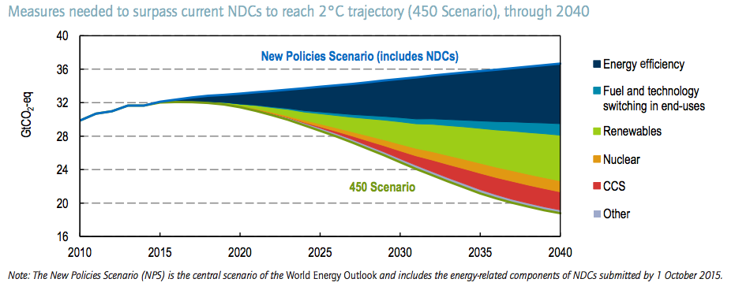

Slide 37
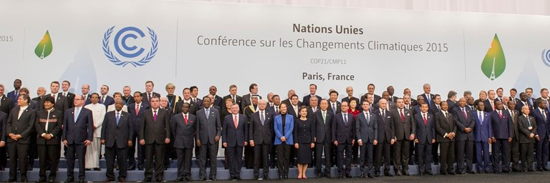
Can the Paris Agreement Survive?
Notes:
UN Framework Convention on Climate Change (UNFCCC) agreed to in 1992
Kyoto Protocol went into force in 2005
Incremental progress each year since 2007
Break down the Kyoto Protocol structure
Incorporate issues beyond mitigation (adaptation, finance, technology transfer)
Increase participation and ambition
Most see Paris outcome as incremental as well though rhetoric suggests otherwise

Slide 38
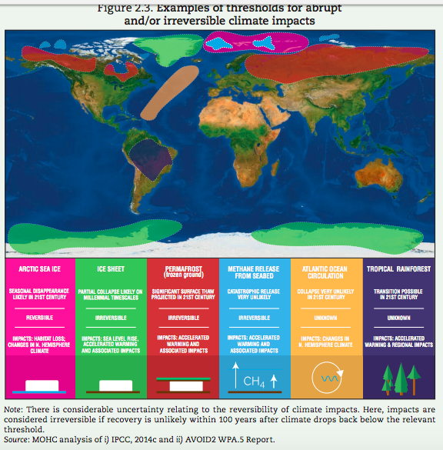
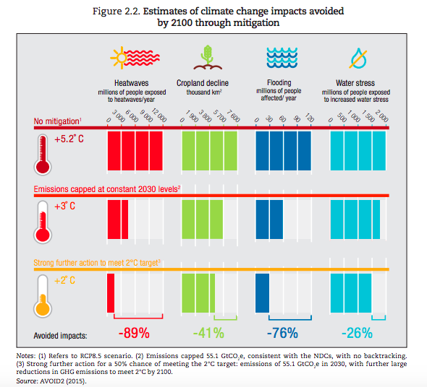
Adaptation Costs are High but Unavoidable

Slide 39
Areas of Uncertainty
Economic optimism masks potential headwinds as near-term energy demand growth picks up pace and energy-intensity of economic growth an area of increasing importance
Oil and gas markets continue toward a fragile rebalance and, absent a supply disruption, prices likely to remain lower for longer, even with extended OPEC agreement
Technological, policy, and market changes continue to reshape established and developing electric power sectors in terms of generation mix, efficiency, and nature of the grid
Growing consensus that current climate efforts fall short of Paris Climate Agreement as action moves from government policymakers to investors and courts
Resurgence of great power politics and “proxy wars” complicate global engagement
Transnational trends – populism, anti-globalization, radicalization, and migration – undermine institutions, governance and relationships
Economic statecraft, including sanctions and trade, will continue to reshape domestic energy markets, patterns of investment, infrastructure build out, pace of energy development and energy trade flows
Notes:
Quadruple “post” period
Post-Great Recession (2008)
Post-Oil Price collapse (2014)
Post-Paris Climate Agreement (2015)
Post-US Presidential Election (2016)

Slide 40






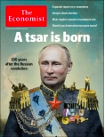
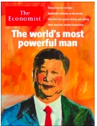

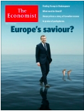

Big Power Politics and Proxy Wars…
Still strongest but no longer superpower
How to build coalitions?
Resurgent global antagonist – strength in opposition
How to right the ship?
Slowing rise into co-equal global power and rival
How to engage without conflict?
Declined global power status
How to build norms?
Region in chaos; host of proxy wars
New source of order?
Are new (and old) leaders and systems up to the challenges?

Slide 41
Areas of Uncertainty
Economic optimism masks potential headwinds as near-term energy demand growth picks up pace and energy-intensity of economic growth an area of increasing importance
Oil and gas markets continue toward a fragile rebalance and, absent a supply disruption, prices likely to remain lower for longer, even with extended OPEC agreement
Technological, policy, and market changes continue to reshape established and developing electric power sectors in terms of generation mix, efficiency, and nature of the grid
Growing consensus that current climate efforts fall short of Paris Climate Agreement as action moves from government policymakers to investors and courts
Resurgence of great power politics and “proxy wars” complicate global engagement
Transnational trends – populism, anti-globalization, radicalization, and migration – undermine institutions, governance and relationships
Economic statecraft, including sanctions and trade, will continue to reshape domestic energy markets, patterns of investment, infrastructure build out, pace of energy development and energy trade flows
Notes:
Quadruple “post” period
Post-Great Recession (2008)
Post-Oil Price collapse (2014)
Post-Paris Climate Agreement (2015)
Post-US Presidential Election (2016)

Slide 42

The Great Global Awakening
Challenges the Legitimacy of All Nation States and the Future World Order
Backlash to Globalization
Realism Redux
Radicalization
Isolationism
Liberal Resilience
Populism
Opportunistic Chaos
Curbing Capitalism

Slide 43
Areas of Risk, Opportunity, and Uncertainty
Economic optimism masks potential headwinds as near-term energy demand growth picks up pace and energy-intensity of economic growth an area of increasing importance
Oil and gas markets continue toward a fragile rebalance and, absent a supply disruption, prices likely to remain lower for longer, even with extended OPEC agreement
Technological, policy, and market changes continue to reshape established and developing electric power sectors in terms of generation mix, efficiency, and nature of the grid
Growing consensus that current climate efforts fall short of Paris Climate Agreement as action moves from government policymakers to investors and courts
Resurgence of great power politics and “proxy wars” complicate global engagement
Transnational trends – populism, anti-globalization, radicalization, and migration – undermine institutions, governance and relationships
Economic statecraft, including sanctions and trade, will continue to reshape domestic energy markets, patterns of investment, infrastructure build out, pace of energy development and energy trade flows
Notes:
Quadruple “post” period
Post-Great Recession (2008)
Post-Oil Price collapse (2014)
Post-Paris Climate Agreement (2015)
Post-US Presidential Election (2016)

Slide 44
Economic Statecraft
Growth and Export Strategy
Sanctions
Trade & Tariffs
Successful pressure on North Korea
Hot potato on Russia
Action forcing on Iran
Potential tipping point in Venezuela
New Asian free trade block
NAFTA modernization
Tariffs on solar panels
Tariffs on steel and aluminum
Chinese IPR tariff escalation
China’s Belt & Road Initiative
Saudi Vision 2030
U.S. energy dominance
Made in India
Russia investment in the Middle East

Slide 45
U.S. Oil Exports
Data source: EIA
Million barrels per day
The Changing Energy Landscape

Slide 46
Demand Growth Centers Are Shifting
Data source: IEA
The Changing Energy Landscape

Slide 47
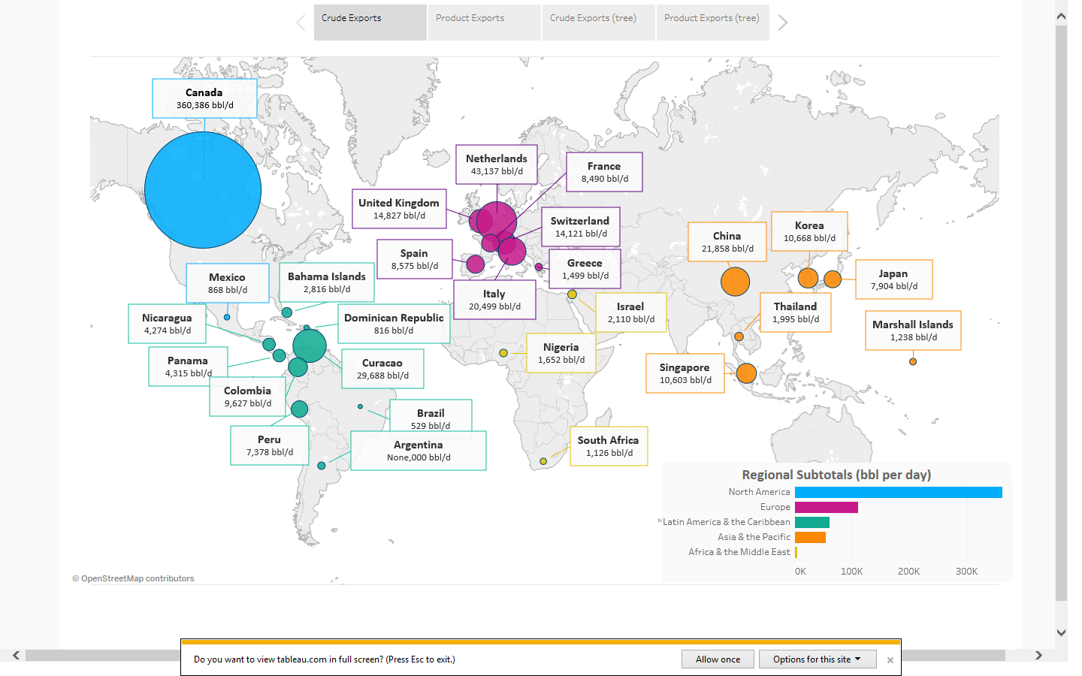
U.S. Crude Oil Exports 2016
Data source: EIA
The Changing Energy Landscape

Slide 48
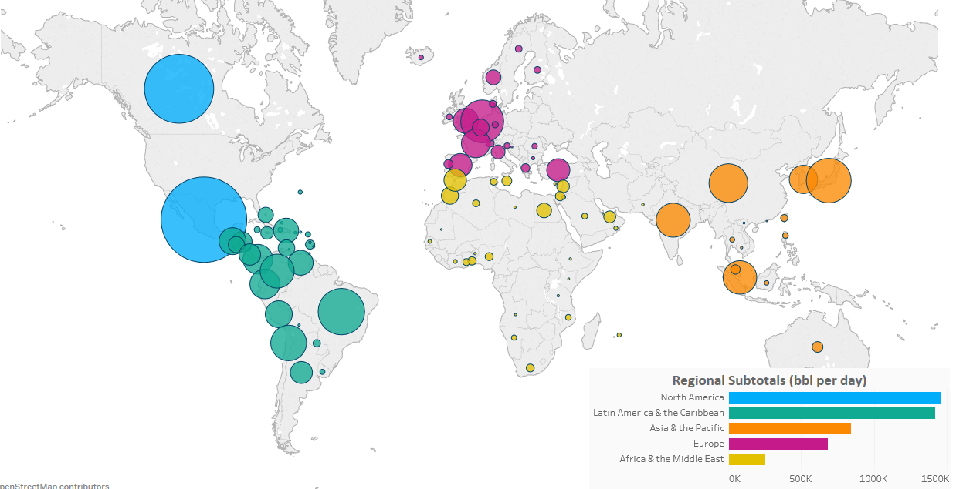
U.S. Product Exports 2016
Data source: EIA
The Changing Energy Landscape

Slide 49
Natural Gas Consumption and Production Scenarios
Data source: EIA
Trillion Cubic Feet per Year
Consumption
Production
The Changing Energy Landscape

Slide 50
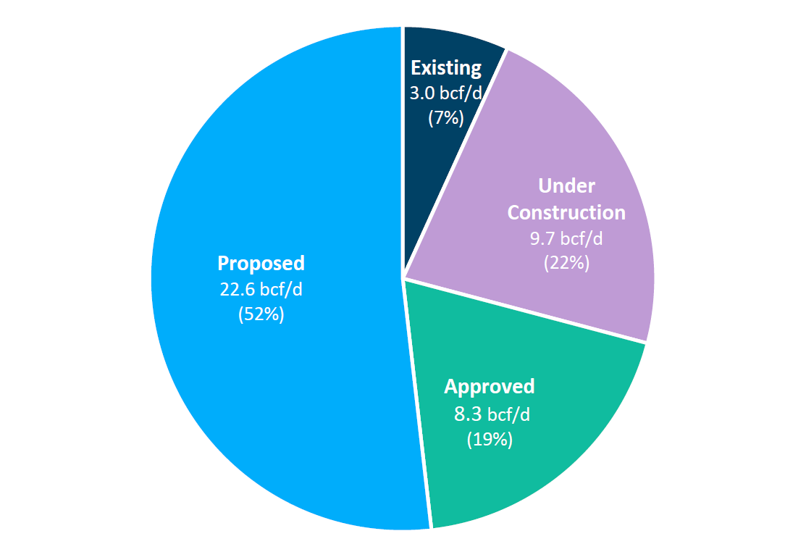
LNG Export Terminals
Total Possible Capacity: 43.6 bcf/d
Data source: FERC
The Changing Energy Landscape

Slide 51
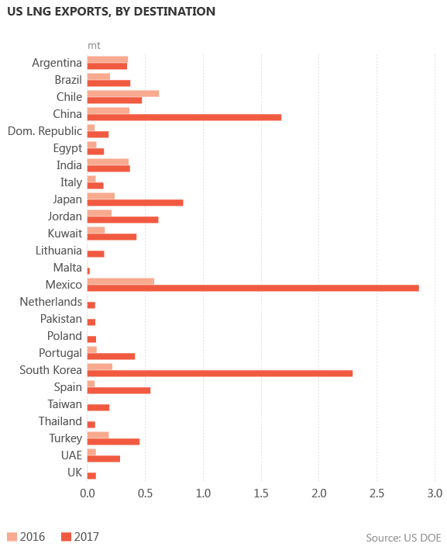
Data Source: EIA
U.S. LNG Exports
Billion Cubic Feet per Day
Net Exports
The Changing Energy Landscape

Slide 52

The Three C’s Shaping Energy Markets
Developing countries
Power of consumer choice
The “China model”
Oil markets
Natural gas markets
Declining markets
Advanced energy technologies
$
Competition
Regional or global conflict
Trade and sanctions escalation
Resilience and climate change
Cybersecurity
Crises
Consumers
Developing countries
Power of consumer choice
The “China model”
Notes:
Economic / population growth trends
Innovations in Buildings / Industry / Transportation efficiency
Electric vehicles / Autonomous vehicles
Wind / Solar cost reductions
Utility and grid-scale batteries / super-grids / distributed power
Shale – enhanced recovery rates
Automated drilling /smarter completions and tie-ins
Carbon tax, fee / Carbon capture, use, and sequestration (CCUS)
Nuclear: Small Modular Reactors (SMRs) / Fusion

Slide 53
About Us
The CSIS Energy & National Security Program is a leader in understanding and analyzing the shifting global and domestic energy landscape. Our approach seeks to analyze and explain the intersection of policy, markets, and technologies. The team is comprised of scholars with a wide range of professional experience in the private and public sectors as well as firsthand regional expertise, who work together to formulate innovative yet pragmatic policy recommendations.
Continuing its collaboration with leaders in industry, government, academia, and nonprofits, the CSIS Energy & National Security Program has events and projects designed to help decision-makers craft smart energy policies that balance economic, environmental, and security priorities.
Notes:
- Non-Profit, Bipartisan, Centrist American Policy Research Institution (“think tank”), founded in 1962
Core Mission: Provide rigorous, independent, thoughtful analysis to help policymakers make better informed decisions
Also mobilize expertise, build networks, convene public and private workshops and sessions to catalyze action and help shape the policy agenda
Of 6,800 think tanks globally, CSIS rated #1 for Defense & National Security for the past 6 years
…and do that on the strength of 200+ full time scholars with varied public and private sector backgrounds & expertise
Plus a wide range of non-resident affiliates
Program areas range from International Affairs/National Security to Global Health, Energy, Trade, Cyber and Regional Expertise
Trustees and Advisory Boards include a “Who’s Who” of foreign & public policy thought leaders as well as philanthropists and corporate executives
Funding comes from government, foundations, individuals, and corporate sponsors
Reports and projects available to the public and we retain intellectual control over content
Available through the internet, social and print media, podcasts/itunes, and expert testimony before Congress

